Slide 1

The year in review
Dec. 11, 2025

Slide 2

As always – highs & lows

Slide 3
The good news: We’re still here - and still doing great work!

Slide 4
Responding to changes in federal policy, priorities, funding
SDSU Research Foundation, fiscal year 2024-25:
Overall award total $200,899,416
COE: 119 awards = $27,655, 327
Interwork: 65 awards, $22,081,598

Slide 5
Thanks to the efforts of the Principal Investigators!
Meera Adya
Mary Baker-Ericzén
Chuck Degeneffe
Eric Felix
Mari Guillermo
Frank Harris III
Felisha Herrera Villareal
Toni Saia
Caren Sax including funds for EFRC & CSA*
Mark Tucker
Xiwei Zhu
Drew Karhan
*With special thanks to
Ian Pumpian, co-PI for CSA projects

Slide 6
Who each relied on the expertise & experience of those whose don’t hold the PI title, but write proposals & reports, direct/coordinate projects & services, provide fiscal and administrative support, & make the technology work (apologies if I missed anyone):
John Summerfruit, Kathy Fleming, & Allie Rosenbloom
Minah Oh & the CDL Team
Chaz Compton
Drew Karhan, Chip Kenney, Amber McConnell, Patricia Henke, & Essie Jones
Cheryl Fuller & the NRLI team
Joyce Clark & Lupe Rojas-Sanchez & the EFRC team
Josh Belfy & Mary Ellen Sousa & the CSA team
Theresa Lally

Slide 7
Department of Administration, Rehabilitation, & Postsecondary Education (ARPE)
Degree Programs
Certificate Programs
Ed.D. in Community College Leadership
B.S. and undergraduate minor in Leadership Studies
M.A. in Postsecondary Educational Leadership and Student Affairs (PELSA)
M.S. in Rehabilitation Counseling
Cognitive Disabilities
Co-Occurring Disorders
Psychiatric Rehabilitation
Rehabilitation Technology
Ed Leadership in Intercollegiate Athletics

Slide 8
ARPE Department updates
Dr. Marissa Vasquez Department Chair
Summer 2025
Promotion & Tenure awarded:
Dr. Mari Guillermo
Dr. Toni Saia
Dr. Tanya G Serrano
New Long-Term Training projects funded to support Rehabilitation Counseling students on campus & via distance education
New BA program in Leadership Studies growing: 120 Major students & 130 Minor student;
First BA grads in May 2026
Taking on leadership roles (AS President, COE Student Council, NCRC, Lobby Corps)
Promotion to Professor:
Dr. Mark Tucker

Slide 9
A few individual highlights:
Dr. Xiwei Zhu joined the ARPE faculty as Assistant Professor in Quantitative Methodology
Dr. Felisha Herrera Villarreal appointed as DRI Fellow for Faculty Programs
Dr. Vasquez will Chair the 2026 American Association of Hispanics in Higher Education Conference at SDSU
Dr. Eric Felix will serve as Graduate Advisor & Program Coordinator of PELSA starting Spring 2026
Dr. Toni Saia was named by the Western Association for Counselor Education and Supervision for the 2025 Research Award
Notes:
DRI = Division of Research and Innovation
PELSA – Postsecondary Educational Leadership in Student Affairs

Slide 10
How ARPE & Interwork intersect for research, student support, professional development:
CDER (Global Campus) Master’s in Rehabilitation Counseling (Dr. Degeneffe and Ms. Thomas)
Community College Equity Assessment Lab (Drs. Harris III and Vasquez)
Community College Higher Ed Access Leadership Equity Scholarship (Dr. Felix)
Lunch and Learn Research Seminar Series (Dr. Degeneffe)
Research and Equity Scholarship Institute on Student Trajectories in Education (Dr. Herrera Villarreal)
U.S. Department of Education Long-Term Training Grants (Drs. Degeneffe, Guillermo, Tucker, and Saia)
Center for Pacific Studies: IS3D BA degree in Palau (via Global Campus); current cohort graduating in May 2026, new BA cohort starting in fall 2026

Slide 11
CDER (Consortium for Distance Education in Rehabilitation)
Dr. Chuck Degeneffe & Rose Thomas
First program started in 1996; most recent cohort of 33 students admitted in Fall 2024 with 14 of them employed by a state VR agency
Cohort model follows a 3-year program, administered via Global Campus, using same courses as on-campus program; CRC exam administered in final spring term (graduation summer 2027)
Faculty/staff: Chuck Degeneffe, Rose Thomas, Mark Tucker, Toni Saia, Mari Guillermo and part-time lecturers, instructional assistants

Slide 12
Long-Term Training grants funded
Rehabilitation Services Administration (2025-2030)
Emerging Scholars
12-15 Scholars/ yr.
Technology for Rehab. &
AI-Integrated Learning
Workforce Development in the CA Dept. of Rehab.
Degeneffe & Tucker
16 Scholars/ yr.
Guillermo & Saia
Adv. Cert. – Cognitive Disabilities, Psych Rehab and Co-Occurring Disorders
8-10 Scholars/ yr.
Adv. Cert. –
Rehab. Tech.
Distance Learning Prog.
Saia & Guillermo

Slide 13
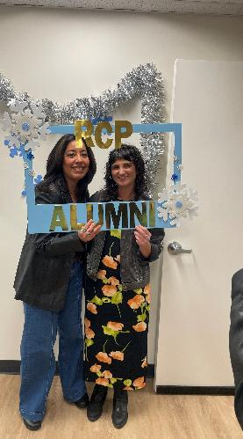
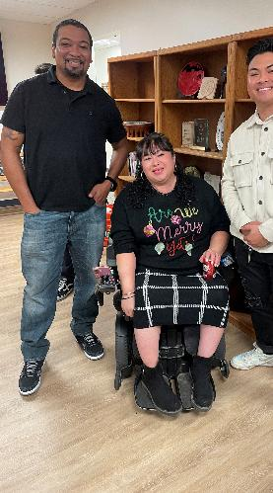
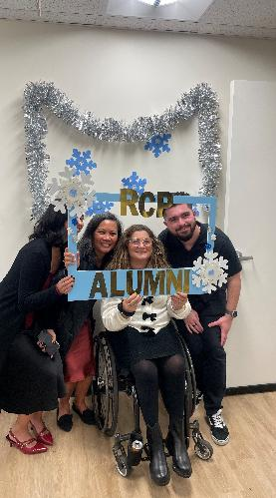
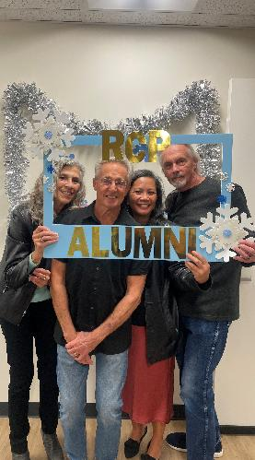
Dec. 2025:
First RCP Alumni event in many years!

Slide 14
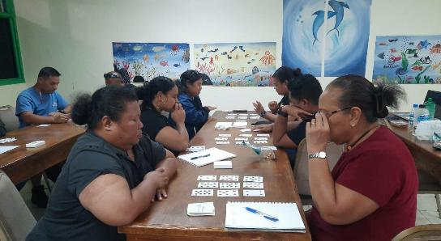
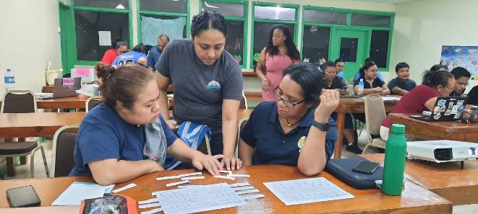
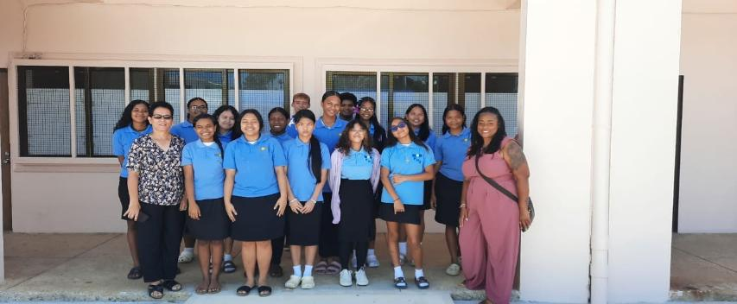
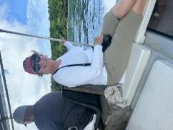
Center for Pacific Studies
Dr. Theresa Lally. Director

Slide 15
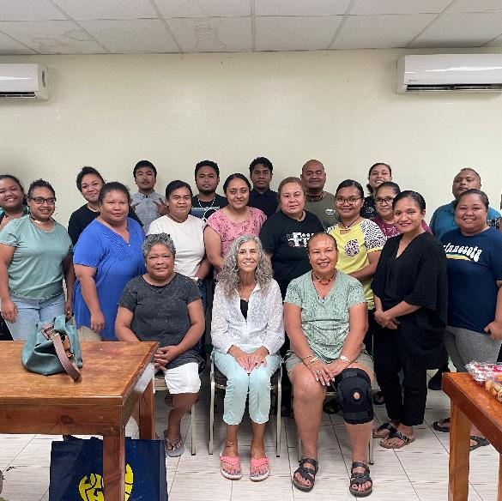
Surprise visit to current cohort: BA in Liberal Arts & Sciences, Major in Interdisciplinary Studies in 3 Departments (IS3D)
26 students ready to graduate in May 2026; started Jan. 2023
Faculty are from: ARPE, STE, DLE, SPED, + those who teach upper division electives including Pacific Oceanography, Anthropology, Asian American Experience - added 2 new instructors from SDSU
Instructors visit local schools, businesses, and outer islands of Peleliu and Anguar.
Planning new BA cohort for Fall 2026

Slide 16
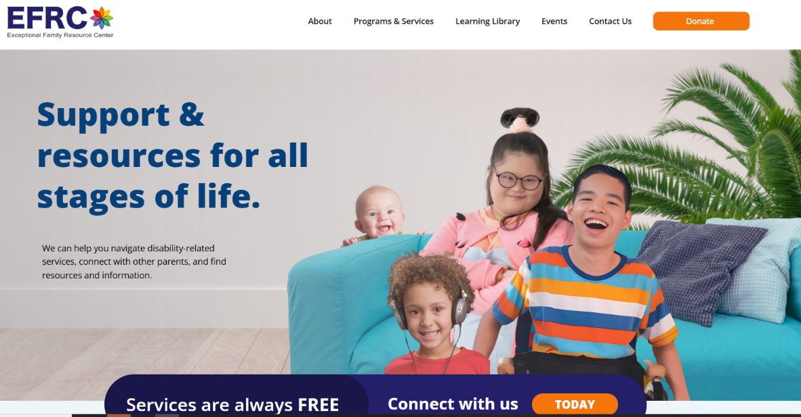
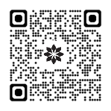
New Website

Slide 17








Workshops & Family Support Activities
EFRC Co-Directors:
Joyce Clark
Lupe Rojas-Sanchez & 20 dedicated staff!
EFRConline
NEW
Play Dates
New
Transition/Adult Services
NEW
IEP Series

Slide 18






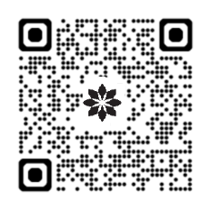
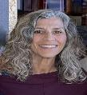

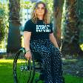

EFRC Community Conference Affiliations
Paula Kluth Inclusion Rules
Steve Allen
PolicyWorks
View EFRConline
NEW
FERIA PARTNERSHIP
Interwork Institute
Disability Visibility
Conference
Dr. Toni Saia
Dr. Caren Sax
SYMPOSIUM
Notes:
Lupe or Joyce 9
EFRC embraces community collaboration
EFRC Staff participate on local conference committees

Slide 19






Family Support Activities
NEW
EFRConline
NEW
Mobile Sensory Experience

Slide 20

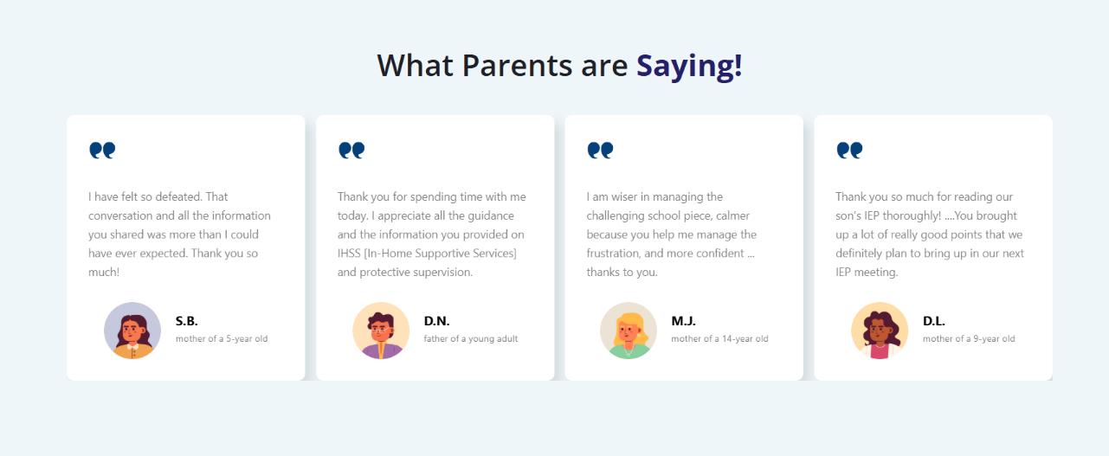
EFRC Success Stories

Slide 21
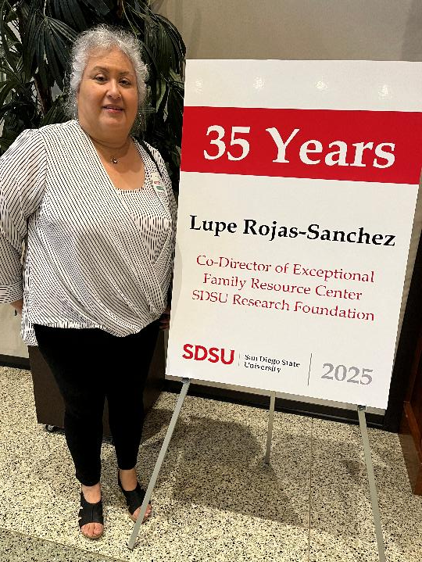
EFRC Co-Director
Lupe Rojas-Sanchez,
honored for 35 years of
service!

Slide 22

-SUCCESS follow-up study of ~100 participants examining employment, mental health & functioning outcomes
-Virtual Interview project, Interview T.I.M.E. (Training Inspired Minds for Employment), multisite R01 enrolled ~50 participants in SD (50 more in 2026)
-Driving program, D.R.I.V.E. and Thrive has new names, new logos and in commercialization phase (see next slides)
ACHIEVE- Autism Research Projects
Dr. Mary Baker-Ericzén

Slide 23
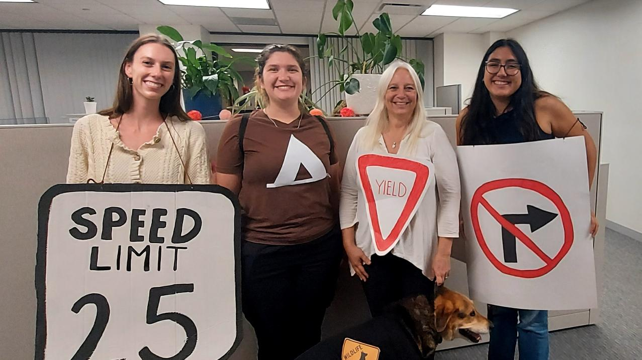
Driving Team- road signs Halloween 2025

Slide 24


Slide 25
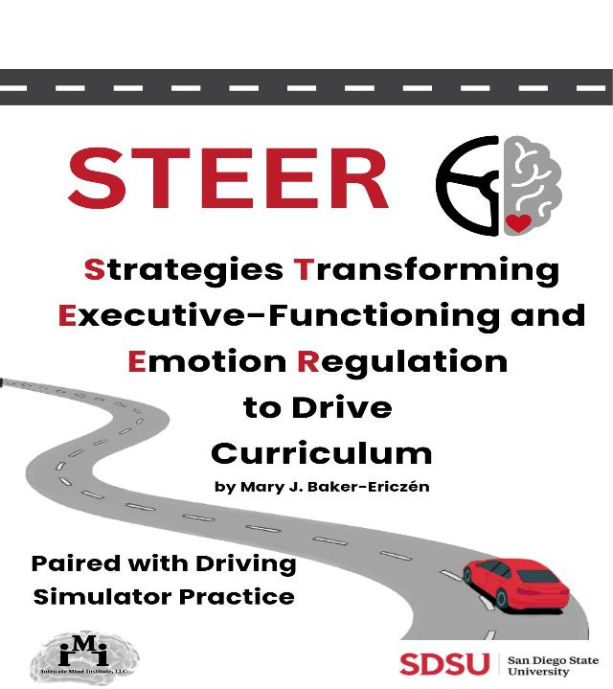

Slide 26
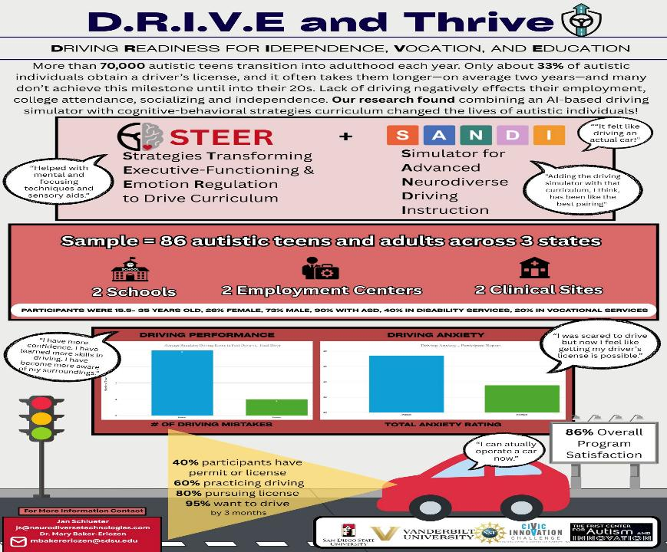

Slide 27
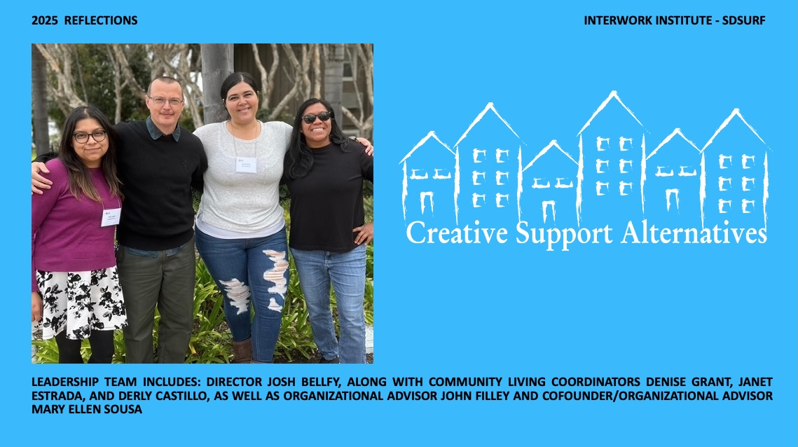

Slide 28
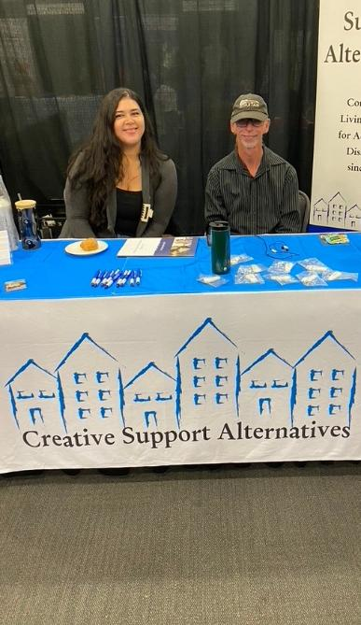
Creative Support Alternatives has a long history of participation in community events and activities with a goal of promoting the possibilities associated with Supported Living Services, providing information and educating community members, self-advocates, families, colleagues, and others while building and deepening partnerships
LEADING THE CHARGE CONFERENCE: COLLABORATING FOR EFFECTIVE SERVICES
INVOLVED EXCEPTIONAL PARENTS DAY: HOSTED TABLE, SHARED INFO AND CONNECTED WITH PARENTS AND OTHERS
RAMONA RESOURCE FAIR: SPREADING THE WORD IN NORTHERN SD COUNTY THAT SUPPORTED LIVING IS AN OPTION FOR ALL!
SDRC 3RD ANNUAL FAMILY AND VENDOR RESOURCE FAIR
SAVE MEDICAID RALLY HELD AT CONGRESSMAN DARYLL ISA’S OFFICE: DSP’S, PEOPLE WE SERVE, AND LEADERSHIP TEAM PARTICIPATED
CSA WAS WELL-REPRESENTED AT THE ANNUAL RACE FOR AUTISM, RAISING AWARENESS AND EDUCATING OTHERS

Slide 29
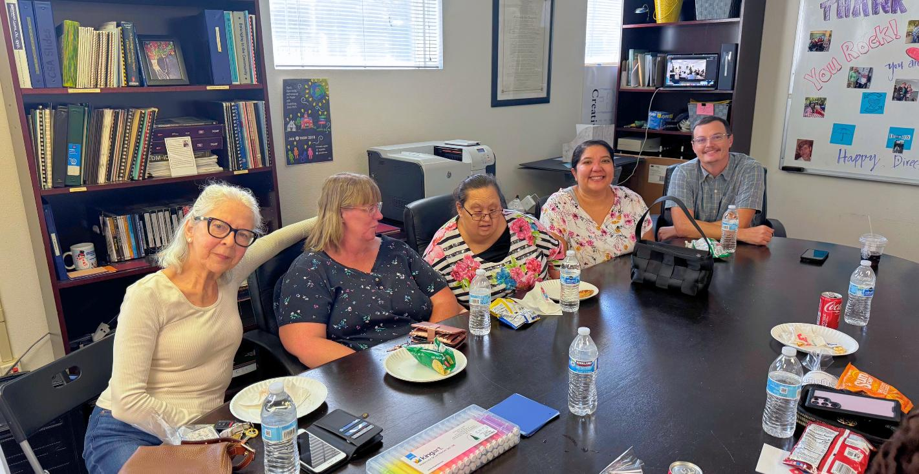
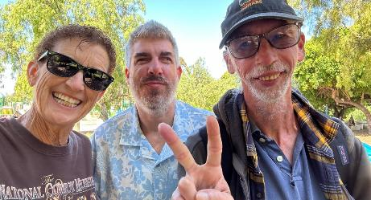
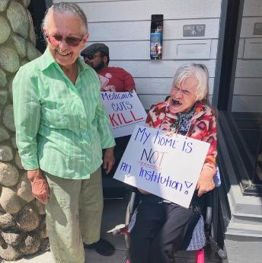
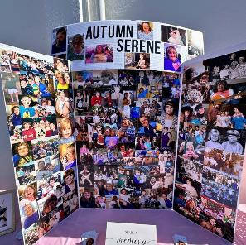
It’s all about relationships & respect!!

Slide 30
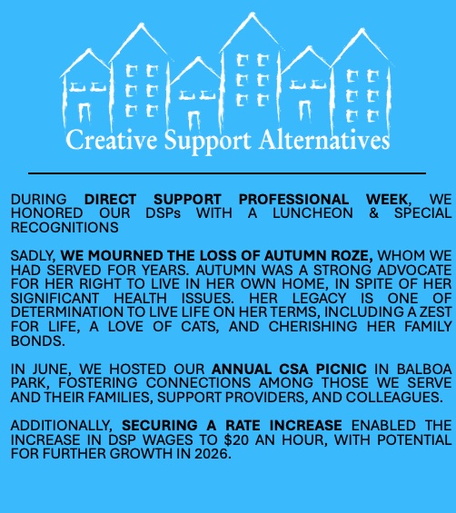
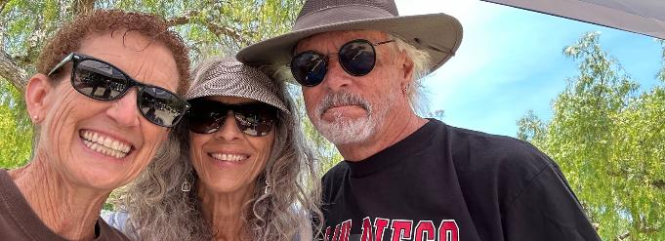

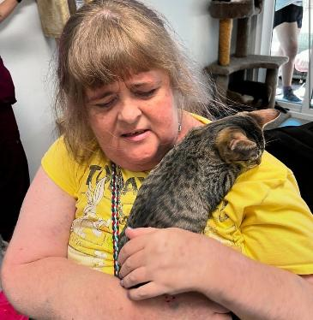
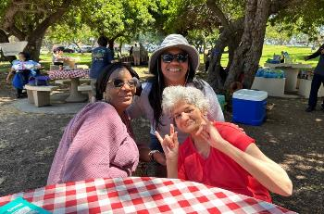

Slide 31
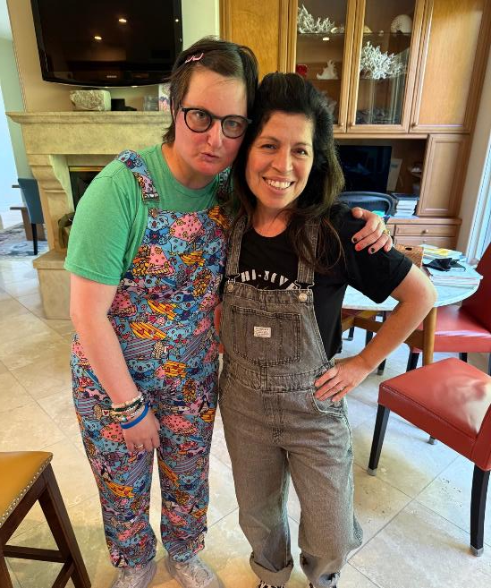
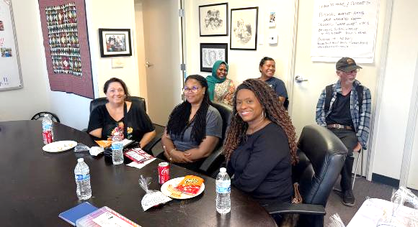
CSA has been involved in the SDRC Supported Living Roundtable meetings, and webinars, trainings & meetings on the DDS initiatives and changes that impact SLS services. This ensures we stay proactive and can respond quickly as funding and regulatory changes occur.
Our efforts during 2025 have generated $2.2 million in funding.
WE ARE EXCITED FOR WHAT 2026 HAS IN STORE AS WE BEGIN OUR 34TH YEAR!

Slide 32
VRTAC &
VR-related projects
Chaz Compton & Team

Slide 33
Success of VRTAC-QM led to new RSA funding!
$30 million (over 5 years) for the new, combined VRTAC-QM + VRTAC-QE = one national VRTAC at SDSU Interwork!
2025 - 2030

Slide 34
VRTAC-QM met/surpassed all goals
(2020-25)
New VRTAC will build on success of relationships, strategies, training, and technology resources
PI: Dr. Mark Tucker
Project Director: Dr. Chaz Compton
Project Co-Director: Dr. Meera Adya
Partners: George Washington University, NDI, YesLMS, Case Review Solutions, Intellitect, and SaraWorks

Slide 35
Other Projects with SVRAs in 2025
CA DOR Integrating Employment in Recovery (IER) - $390,000
DOR TBI Needs Assessment – $165,054
Colorado CSNA – $49,840
Delaware General and Blind CSNA – $76,894
Virginia Blind – $57,791
Virginia General - $77,971

Slide 36

National Rehabilitation Leadership Institute (NRLI)
2025
Cheryl Fuller

Slide 37

NRLI in 2025
The 2025 NRLI faculty included five former state VR directors, one of whom is a former RSA Commissioner, and all faculty have decades of experience in Vocational Rehabilitation:
  Faculty Members: Allison Flanigan, Michael Greco, Kenna Hickman, Mark Schultz, John Walsh, and new faculty member Cheryl Fuller.
Weeklong seminars (sessions) were conducted in February, May, and August, with executive coaching provided during and between sessions. The fourth and final session will be held in February 2026.
As of December, the 2025 NRLI Cohort is a dynamic group of 28 current and emerging VR leaders from 18 State VR Agencies (SVRAs).

Slide 38

2025 Projects: NRLI participants worked in groups to identify an issue affecting the national VR program.
Their work proposed solutions to:
data collection for the RSA-911 report
interstate data exchange among SVRAs
vendor payment structures to focus on outcomes
rebrand the national VR program to better align the program’s name with its mission
improve counselor recruitment, training and retention
create a national framework for new counselor training and professional development

Slide 39
Program Improvements
New topics introduced:
Root cause analysis strategies
Managing change & leading through change
Rapid engagement strategies
Offered a one-day virtual session on leading during uncertainty
First draft of paper presentations prior to final presentations in DC in Feb. 2026

Slide 40
Looking Ahead to 2026
2026 is shaping up to be another great year for NRLI, with 29 applicants from 24 SVRAs.
Mark Shultz and Michael Greco will leave the faculty. We are deeply appreciative for their valuable contributions to NRLI.
Former CSAVR CEO (and former SVRA director) Steve Wooderson, and former California SVRA Director Joe Xavier will join the 2026 faculty.
The faculty would like to acknowledge the invaluable support provided by Kathy Fleming, John Summerfruit, Minah Oh, and Meera Adya. We thank Chaz Compton for his leadership, guidance and support.

Slide 41
Pathways to Success Project
DIF grant with CA DOR
Esmeralda Jones, Director

Slide 42
Project Highlights
1. Systems Built & Launched
Business Engagement Tool (BET)
Automated Vocational Pathways Form (career ladders, salaries, certifications, training routes, IPE-ready downloads)
National Apprenticeship Listings integrated into TCI
2. Reporting & Automation
Designed automated BET reporting (daily, monthly, yearly) that will automate WIOA indicators, including Business Engagement Measure 6 and measurable skill gains
Will remove manual reporting and will increase accuracy once released (Projected for 2026)

Slide 43
3. Training & Capacity Building
Built a centralized Career Pathways & Business Engagement Repository
Career Pathways trainings were highly successful, leading to strong adoption and improved counselor competency
Training success allowed the program to transition from monthly mandatory sessions to a flexible on-demand model
Counselor performance improved significantly, and several counselors were promoted into management roles
Currently creating a secure, authorized-access YouTube training channel for trainees only
4. Collaboration & Expansion
Facilitated introductions with the United States Department of Labor
Facilitated introductions with the California Division of Apprenticeship Standards
PSP counselor and business engagement teams completed neurodiversity trainings with UCSD Tarjan Center
5. User Experience & Workflow Improvements
Designed a more intuitive TCI landing page
Standardized workflows for business engagement, career pathways, and training access
Pathways to Success

Slide 44
Tech-PIECS: Technology Partners Increasing Employment through Coordinated Services
DIF grant with CNMI: $9.1 million (5 years) with $350,000/yr to Interwork
PI: Dr. Caren Sax
Project Director: Leticia (Letty) Vavasour

Slide 45
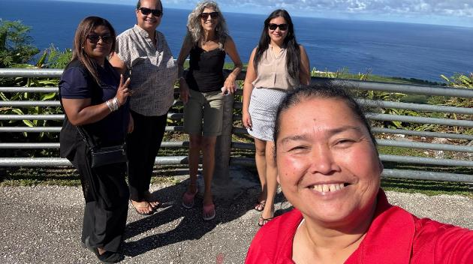
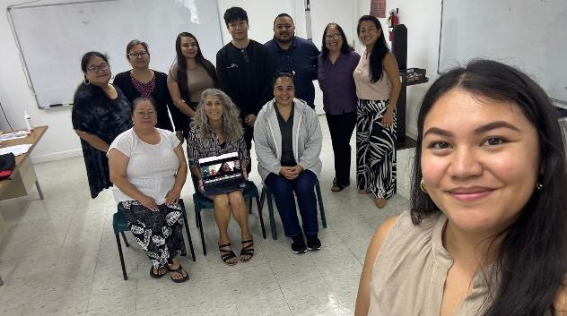
First training with local partners on MPT process in Saipan
Partners:
Northern Marianas College
Office of Vocational Rehabilitation
Center for Living Independently
Council on Developmental Disabilities
Northern Marianas Technical Institute (NMTech)
Interwork & SaraWorks
Overall goal: Provide personalized advanced technology services combined with comprehensive transition and reintegration services to disconnected youth and adults with disabilities with the goal of increasing their independence, education & competitive integrated employment

Slide 46
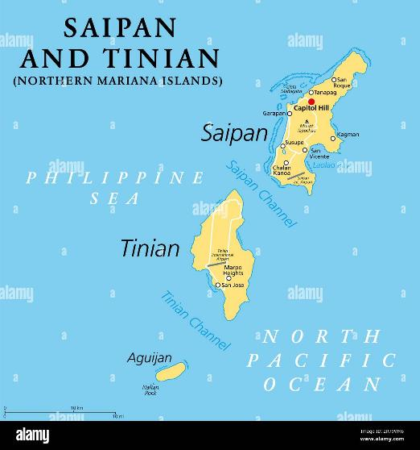
Next steps for 2026
Letty traveling to CNMI to offer training, technical assistance
Francesca (SaraWorks) traveling to CNMI to design technology resources

Slide 47
Transition- & employment-focused projects

Slide 48
Employment Transition Demonstration –
New York
Research demonstration project funded by the U.S. Department of Labor, Office of Disability Employment Policy (ODEP) for 5 years - $1.9 million to SDSU-II
Focus on multiply-marginalized youth population(s) by building upon:
  PROMISE, SSI Youth Solutions, and Guideposts for Success Framework
Partner with NYS Department of Labor, Adult Career and Continuing Education Services –ACCES (VR and Adult Ed), Office of Mental Health, and Youth Power
Serving 800 Youth – Finished Pilot – Full Launch in 2025
Led by Drew Karhan, Amber McConnell, and Karen Little

Slide 49
Center for Advancing Policy on Employment for Youth (CAPE-Youth)
Funded by the U.S. Department of Labor, Office of Disability Employment Policy (ODEP) - 5-year award: $1.4 Million to SDSU-II
Partner with the Council of State Governments, Cornell University, and the National Association of Workforce Development Professionals.
Researches new and existing innovative policy and practice; develops strategic partnerships; shares best practices among key stakeholders; and assists states in changing policy and practice.
Engaging working group states: LA, ND, NH, NV, and WV.
Led by Drew Karhan, Amber McConnell, Patricia Henke, Mari Guillermo, and Mary Baker-Ericzen

Slide 50
New York SWTCIE
Funded by the U.S. Department of Education, Rehabilitation Services Administration: $3 million to SDSU.
Partner with the New York ACCES-VR, New York Independent Living, Griffin Hammis Associates, and Cornell University.
Researches new and existing innovative policy and practice; develops strategic partnerships; shares best practices among key stakeholders; and assists states in changing policy and practice.
Led by Drew Karhan, Patricia Henke, Meera Adya, Wendy Quarles, Erica Taylor, and Minah Oh.

Slide 51
Updates from Minah on the Center for Distance Learning (CDL)

Slide 52
IT Management & Support
General technical support for various Interwork projects
Mailchimp
Google Suite/Workspace
CoPs
eCheckupToGo
Security Gap Analysis (SGA)
Equipment management
Software management

Slide 53

Website Development & Management, Accessibility
VRTAC-QM
VRTAC
CA CSP
NY SWTCIE
Interwork Website
Accessibility via Level Access

Slide 54

ID & Training Development
14 classes – CDER and Palau BA
366 enrollments
5 Journals
VR Counselor Training – South Carolina Blind, New Module 03, Training transition to each SVRA
Transfer VRTAC-QM Training from D2L to II-CDL hosted LMS

Slide 55
Web Application Design & Development
VR Time Study
Advanced Analytics and Custom Dashboards
AI-powered Features in VR Time Study
Chat with Chart: Conversational Data Interaction
Interactive Walking Tour/Guided Tutorial
Web Application Design & Development

Slide 56
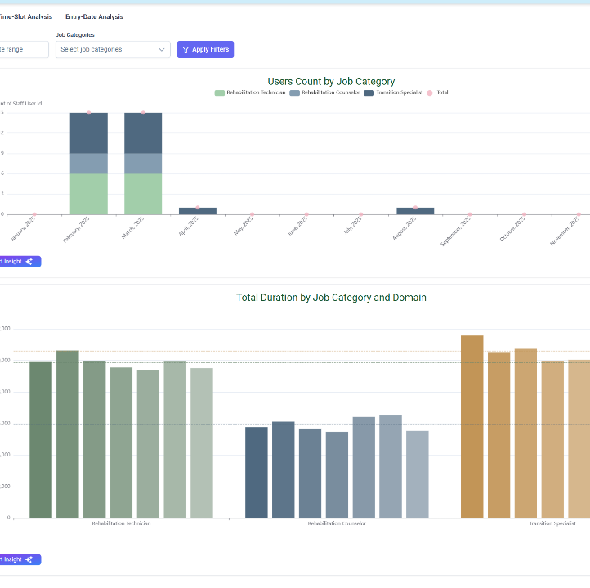
Advanced Analytics and Custom Dashboards
Tableau-like layouts with fully customized data views based on roles and permissions
Integrated advanced charting library
Highly interactive and visually rich analytics

Slide 57
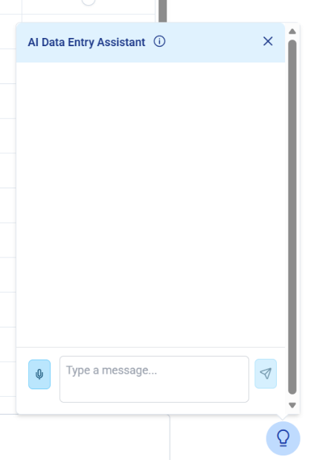
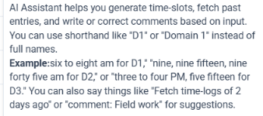
AI-Powered Features in the VR Time Study App
AI capabilities that simplify data entry within the VR Time Study application
  Users can now use Natural Language Processing (NLP) to enter data (for example, saying “six to eight for D1” auto-fills the relevant fields with intelligent suggestions)
Integrated Speech-to-Text and Text-to-Speech (STT/TTS) features

Slide 58
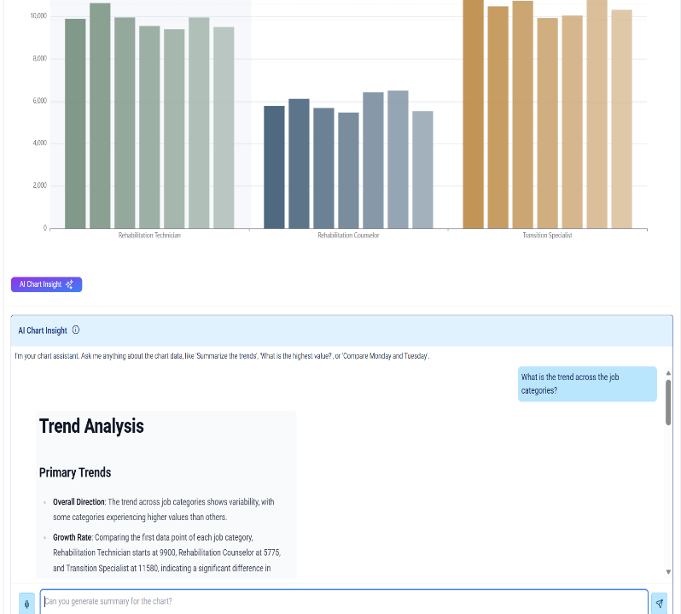
Chat-with-Chart: Conversational Data Interaction
Users interact with charts using integrated AI tools and natural language models
Easily find summaries, trends, insights, and detailed explanations
Enables easier and faster data exploration

Slide 59
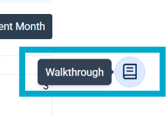
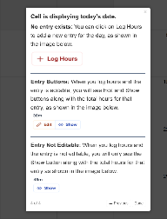
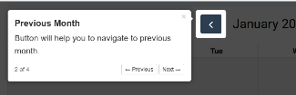
Interactive Walking Tour / Guided Tutorial
Guides users through key features and use cases within the application
Enhances onboarding and reduces the learning curve for new users

Slide 60

II-CDL
Growth & Improvement
Expand our skills and knowledge
Deepen and strengthen our existing capacities
Maintain being healthy and happy through good and bad days
Foster a positive, productive, and strong team!

Slide 61
Efforts across Interwork

Slide 62

Collaborating & Communicating
Internally & Externally
“Interworkings” – ongoing meetings to highlight efforts and look for new ways to collaborate across projects, centers within Interwork
LinkedIn – Interwork has its own page
Redesigning Interwork’s website content to display & market what we do to other audiences
Utilizing Group Concept Mapping to understand the breadth and depth of SDSU-II
  Three Phases – Brainstorming, Sorting, and Rating
  We need FULL participation
  Jan-Feb

Slide 63
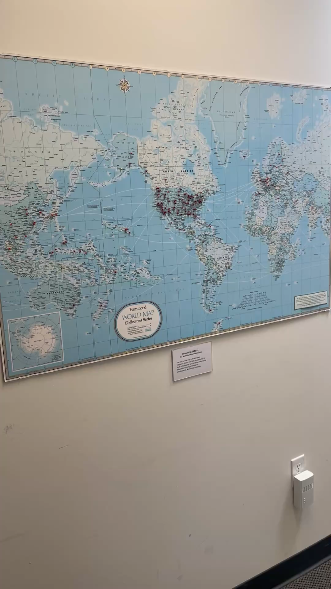
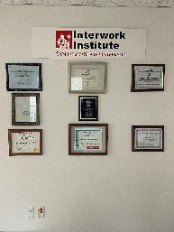
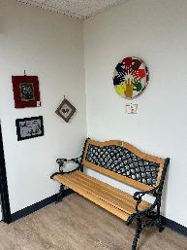
Physical changes at Interwork
CSA moving from across the street to our building
Toni moving into Fred’s office
Building out timeline with photos of vintage Interwork efforts & partnerships, “appreciation wall”
Let’s add more!

Slide 64
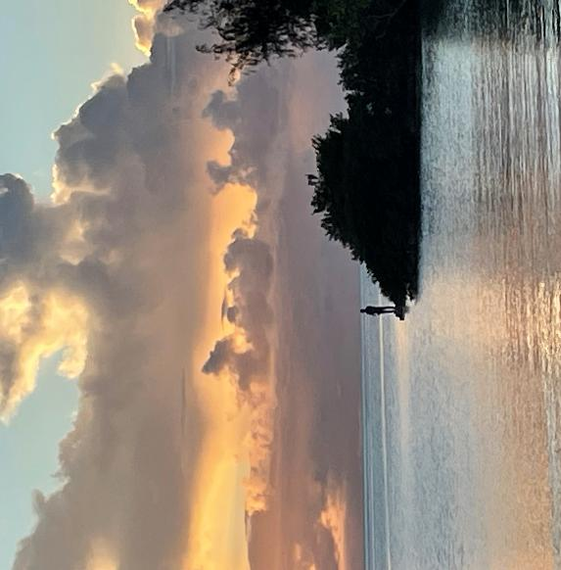
A moment of gratitude
Thanks to each of you for all you do every day to make the world a bit better, kinder, and compassionate.
Enjoy a peaceful holiday season.

