Slide 1
Take Charge: Leading the Transition to Adulthood
Caren L. Sax, EdD, CRC
SDSU Interwork Institute
Kristoffel van de Burgt & Melissa Hough
Creative Support Alternatives
Funded by CA State Council on Developmental Disabilities, Area Board 13
Notes:
This presentation was done for the Area Board 13 Board of Directors to provide a summary of what was happening with the project.

Slide 2
Take Charge: The process
Awareness & Recruitment
Training of graduate students
Facilitating Plans
Next steps
Notes:
The presentation addresses how we recruited participants for the project, how we trained the graduate students who helped to facilitate the meetings, how the meetings were conducted and what else was planned.

Slide 3
Awareness & Recruitment
Re-introducing PDP
Whatever happened to person-centered planning?
Notes:
The concept for the Take Charge Project began at the 2012 IEP (Involved Exceptional Parents) Day Conference in San Diego. Parents attending a transition-focused session were asked if they had heard of person-centered planning. Very few raised their hands. When asked if they had ever experienced it, only two parents responded that they had participated in this type of planning, one of which explained that her daughter had a plan done 20 years ago. While many school and adult agency personnel claim to use a “person-centered approach” to transition planning, the outcomes often don’t back up the claims. Take Charge was proposed to educate transitioning youth, their families, and local community stakeholders by supporting and demonstrating the use of person-centered planning in the transition process.

Slide 4
Shifting the Emphasis to Person-Driven Planning
Notes:
The proposal included a shift in language, from person-centered to person-driven. This was done intentionally to renew the focus on the individual being in charge of their planning. Since so many claim that they do person-centered planning, it was important to talk about it in a different way to help professionals and families consider if they were truly supporting a person-driven approach for planning, or PDP.

Slide 5
~ Interagency transition meetings ~ Collaborative Transition Committee: Let’s Talk Transition ~ Education Roundtables ~ IEP Day ~ Camp Pendleton
Re-introducing PDP
Notes:
We started the project activities by conducting many workshops and presentations, and used these opportunities to recruit participants. We contacted many colleagues who work with transition-age youth, both from the school side and from the adult services side, as we targeted young adults from 18-25. We also asked staff from the Exceptional Family Resource Center to contact families directly.

Slide 6
Number of participants in workshops & presentations by end of Q2: 320 Including focus individuals, families, transition teachers, RC service coordinators, rehabilitation professionals, community agency staff
Re-introducing PDP
Notes:
At the time of this presentation, we were about halfway through the project. Over the course of the one-year project, we provided educational presentations and training for more than 500 students, families, transition teachers, adult service providers, and Regional Center staff on the use of PDP to support young adults to pursue inclusive employment, postsecondary education and community living. The goal was to help build capacity for families and professionals to continue using the philosophy of PDP to support transitioning youth.

Slide 7
Training students
Teamwork
How do we get the best team?
Notes:
Given that the PI is also Chair of San Diego State University’s Department of Administration, Rehabilitation, and Postsecondary Education (ARPE), we wanted to include Rehabilitation Counseling graduate students in the project. We wanted them to have first-hand experience in facilitating PDP with families, providing them insights into the importance of consumer choice and empowerment. We offered a workshop to all students who were interested in learning about the PDP process and tools.

Slide 8
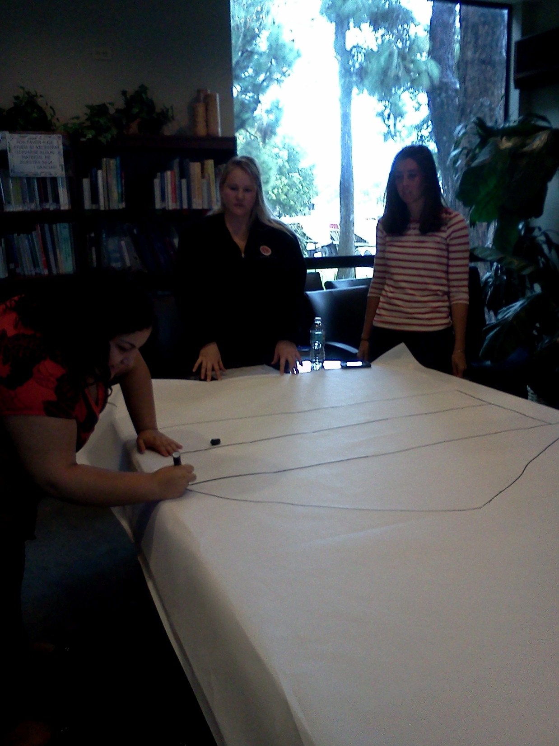
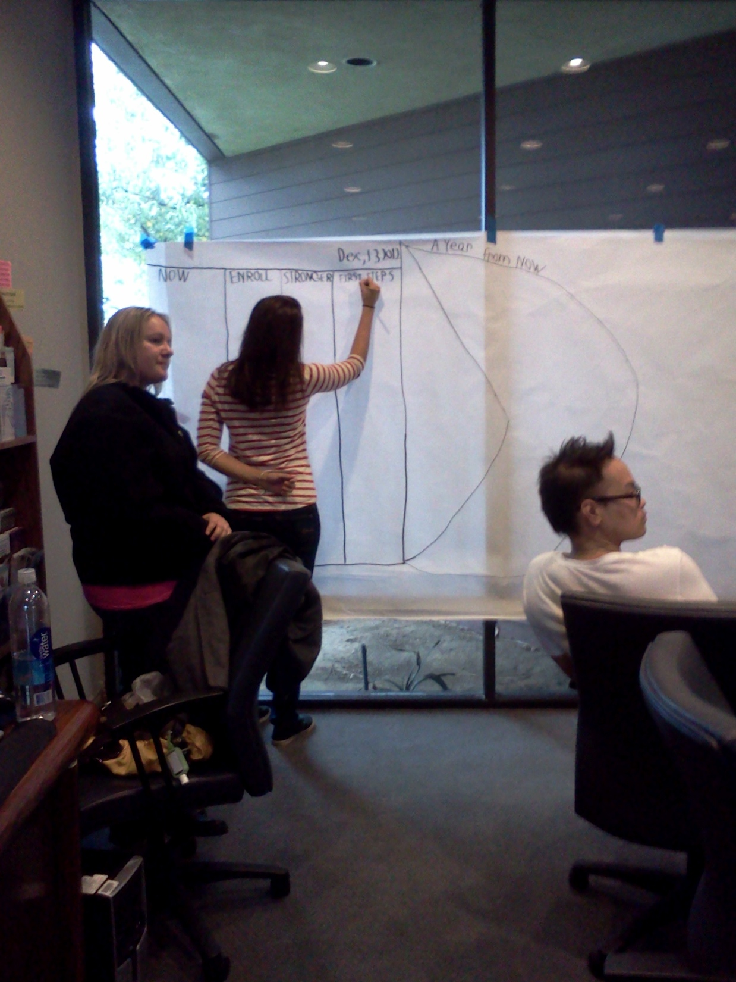
Building skills
Overview
Hands-on training
Observing plans
Facilitating with leaders
Independent facilitating
Notes:
We did extensive training with the four students who were hired for the project. After providing an overview, history, and philosophy of the process, we engaged the students in hands-on training so that they could practice with each other. They learned tips for facilitating and recording, as well as establishing rapport with families and how to set up pre-meetings. There were three of us who had experience in conducting PDPs, so we had the students observe us facilitating and recording in a meeting (with permission from the family). For several months, we co-facilitated meetings together with students, until they felt comfortable enough to conduct them with each other. The Take Charge Team conducted meetings with more than 20 families.

Slide 9
Student comments
Results
“I have to say that it has been one the most rewarding aspects in my first year in the program. Seeing the clients and their family feel a sense of direction and confidence tells me that that any accomplishment can be done. Seeing the client feel empowered and take control makes me feel I am doing the right thing.” ~JG
“The Take Charge program brought positivity that transition aged students most likely have not experienced in the past. The change in both the client's demeanor and the parents' understanding and beliefs about their child completely changed after participating in these meetings. The Take Charge project is a catalyst to change by identifying and moving toward a client's hopes and dreams.” ~TN
Notes:
These are comments from Rehabilitation Counseling graduate students involved in the project as facilitators and recorders.

Slide 10
And one more:
Results
“Through my involvement with Person Driven Planning, I have learned that paths and maps can be very empowering. By helping to create a visually vibrant story, young adults in the transition process of their lives can better gain control of their dreams and desires. Each individual is unique and special, which makes every story different and exciting.” ~KL

Slide 11
Facilitating Plans
The real work
Are we making a difference in the lives of individuals with disabilities as they transition to adulthood (ages 18-25)?
Notes:
Following are some examples of what we learned in facilitating PDPs.

Slide 12
Luke’s Adventures
Luke’s PATH
Notes:
Luke was already out of school and just beginning a Tailor-Day program with a local agency. A new staff person was just starting to work with Luke, so participating in his PATH helped the staff member to get acquainted with Luke and understand his dreams and ambitions. The staff member said that he learned more in the 45-minute PATH meeting than he did in the several weeks he had just spent with Luke.

Slide 13
Nikki’s Awesome Meeting
Nikki’s MAP
Notes:
Nikki was excited to set up her own meeting at the Urban Skills Center, a transition program in San Diego. She enjoyed being in charge of the process, deciding who to invite, what food to serve, and the type of meeting she wanted. She also helped with some of the drawing, as she has very good artistic skills. Her experience encouraged other students in her school to set up their own meetings.

Slide 14
Looking forward with Devon
Devon’s PATH
Notes:
Devon was receiving services from an adult agency in the San Diego area that was trying to improve their ability to provide person-driven services.

Slide 15
Rigo’s PATH to SD
Rigo’s PATH
Notes:
Rigo, a member of the Area Board 13, attended a workshop in Imperial County and was interested in having a PATH plan for himself. He wanted to have it held in San Diego, as he wanted to invite friends and colleagues who knew him in his professional role. He told us later that he continues to consult with his PATH ideas when he’s making significant decisions.

Slide 16
Jory’s Future
Jory’s PATH
“Thank you for allowing Jory to reach for dreams as we sat in delight watching him come to terms with something completely new!”
Notes:
Although he was still attending a school transition program, Jory was planning to move into his own house (close to his parents’ house) where he would be receiving Supported Living services. The focus for his PATH was related to the upcoming move. Jory was engaged in the process by adding photos and images to the PATH to indicate his dreams.

Slide 17
Total number of plans by end of Q2: 10
The real work
Including at least one pre-meeting with each individual, family, teacher/other interested professionals

Slide 18
Next steps:
Next steps
How do we keep building the interest, raising the expectations?

Slide 19
Goal: Complete at least 18 plans by Sept. 30, 2013
Next steps
On track to accomplish this goal
Notes:
Again, this presentation was offered about 7 months into the project. After a year, this goal was exceeded.

Slide 20
Goal: Offer 5 workshops (4 in SD &1 in Imperial counties) to at least 200 people
Next steps
Completed 7 workshops & 4 presentations; on track to meet larger goal of participating in additional community events to reach at least 500 people
Notes:
After a year, this goal was also exceeded, as mentioned earlier.

Slide 21
Goal: Create Take Charge website
Next steps
Sharing stories is the focus; beta version is underway; site will go live soon!
Notes:
The website can be found at: http://interwork.sdsu.edu/sp/takecharge/

Slide 22
Goal: Highlight micro-enterprise efforts & hire peer consultants
Next steps
Still underway; have 2 potential peer consultants
Notes:
Collaboration with another funded project helped in working with young adults interested in micro-enterprise. A decision was made to not hire the peer consultants, as there wasn’t adequate time to bring them into the process in a meaningful way.

Slide 23
Follow-up?
What happens after a plan?

Slide 24
“For the first time in many years I felt that Felix wanted to look forward into the future.”
Notes:
This comment from Felix’s mother spoke volumes as to the impact that his PATH had on Felix’s attitude and motivation.

Slide 25
Interest in following up to determine the degree to which information in the plan is incorporated into “official” plans (IEP, IPE, IPP, etc.) & more importantly, into real life!
Next steps
Notes:
We have been able to do limited follow up with some of the families through support from another project. The information has been incorporated into the “Real Stories” on the Take Charge website.

Slide 26
“It was really different from a 2-hour meeting where everyone else made decisions about my life!”
Notes:
This quote sums up a comment by a young man with Aspergers who had experienced a PDP.

Slide 27
Guiding Principles
The individual is in charge: they decide who attends the meeting, where it should be, and what goes on their plan.
The meeting must be voluntary for all attendees – and everyone must agree to stay for the whole plan.
A pre-meeting is held to interact with the focus-person and family to determine the goal and logistics for the meeting and to determine how to best support the individual to be fully engaged in the meeting.
Everyone must attend a meeting with an open mind, allowing for the opportunity to think in new ways, investing in a different way to dream and attain dreams.
Share ideas that are positive and possible!
Notes:
These principles were used in setting up the PDP meetings with individuals and families to make the expectations and processes very clear.

Slide 28
Thank you!
csax@mail.sdsu.edu
619-594-7183

