Slide 1
MAP planning using a computer
- With thanks to Sheryl Bobroff and her transition students
Notes:
This presentation offers an alternative to drawing a MAP on large paper posted on a wall. The facilitator/recorder would set up the template with the various pages to be used in the MAP ahead of time on the computer. During the meeting, the images would be projected on a screen and everyone’s input would be typed in vs. being drawn on paper.

Slide 2
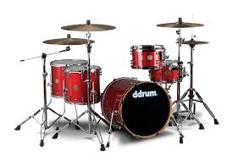
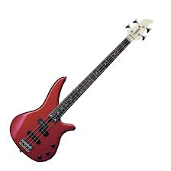
Jon's Future
Planning Meeting
Notes:
Jon wasn’t excited about having folks draw on large paper on the wall and preferred that his MAP be done on the computer with a pre-designed template to fill in by typing instead of drawing. He chose the illustrations, pulling images from Google images and other websites.

Slide 3
FAMILY
Sue (Mom)**
John (Dad)**
SCHOOL / AGENCY
FRIENDS
Karen (Girlfriend)**
Mason (Friend from Urban Skills Center)
Jon
Teachers & Staff from USC
Mr. Johnson**
Ms. Turner**
Coach De Broux**
Mrs. Bobroff**
Mrs. Taylor**
Pam Smith (SDRC)**
Mark (group home)
Danny (group home)**
** in attendance
Notes:
This slide shows the participants.

Slide 4
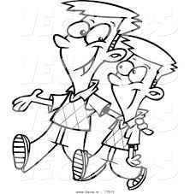
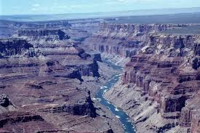
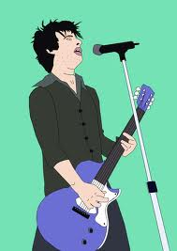
Jon's History
Born: May 21, 1991
Learned English at home, started
Kindergarten at 6 years old
Age 5; adopted with
his brother (Dave)
Went to Linda Vista Elem.for 4rd-6th grade
Started to play soccer, went to Warner Springs, played little league; enjoyed dancing and playing the drums
Travelled to Grand Canyon, up the coast
Youth Group at Church ; last 2 years participating in “Young Life”, activities include singing
Canyon Crest for 2 years
Started USC, then to Springall, then back to USC
At 18 moved out to a “home”, then moved to current group home
Today:
November 27, 2012
Notes:
Jon’s history was shared with the highlights in his life.

Slide 5
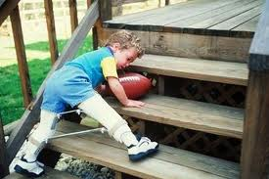
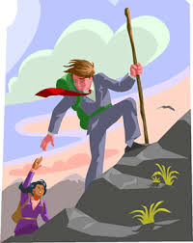
Jon's Strengths
Leadership on sports teams; natural born leader
responsible
Mentor to younger kids
friendly
Athletics
Great with children with special needs
Helpful to others (including at home)
Musically talented (drums/bass)
Notes:
After the information was shared and typed into the template, Jon went back in to add the images; these are showing his strengths.

Slide 6
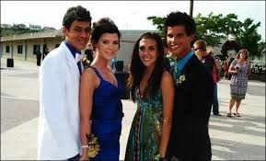
Jon's Activities
HOME
Chores: cut the grass, dishes, keeping his room clean, cooking, laundry (a lot is initiated)
Activities: play video games, jump on the trampoline, skateboard, ride on
the scooter, listen to music, sing, play instruments,
talk to girlfriend, build things
Youth group (singing, play games), Church on Sundays, volunteer work (Meals on Wheels) movies, shopping, walking, goes to brother’s soccer games, swimming
COMMUNITY
Favorite Classes: Sports, music, TA in Elementary Program (4-5th grade), landscaping, budgeting, home maintenance and repair;
Goes to dances (prom)
SCHOOL
Notes:
By filling in the activities for home, school, and community, it was easy to see how Jon spends his time.

Slide 7
What Works?
Take deep breaths or take a walk when frustrated
Small groups, writing things out, a calm relaxing environment
Being outside
Being given a job/clear role
Is given choices
Waiting until he is calm to bring up an issue
Privacy
Tasks with an end point
Physical tasks
Playing drums
Listening to music
Being given a warning about “hard feedback”
What Does NOT Work?
Getting “in his face”
Telling him to calm down
Confronting an issue when agitated
Talking about personal issues in a group
Food service (crowded)
Crowds/chaos, feeling rushed
Public feedback
Talking about Jon in his presence without including him
Notes:
Jon was asked what works and doesn't work for him, while the other participants were asked: how should we behave/ support you? what environments work?

Slide 8
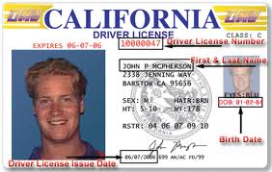
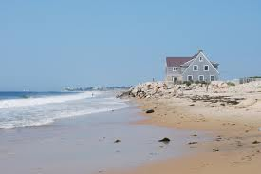
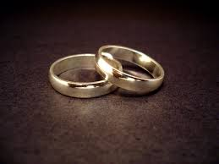
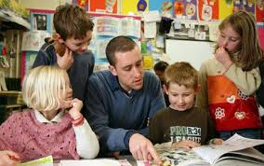
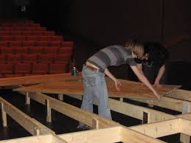
DREAMS
Get a driver’s license
Live in his own place by the beach
Wants his own family;
married and with 2 kids
Getting a job after graduation
Perhaps TA/ working with kids
Building/ construction
Stage crew (theater)
Being a singer or musician
Notes:
Dreams could include all areas of his life: work, school, living arrangements, relationships, leisure/recreation, social, other?

Slide 9
PLANS
WHO Jon, USC staff Jon, USC staff Jon, parents, Regional Center Jon, Girlfriend Jon Jon, USC staff, Regional Center | WHAT Get a driver’s license (take written test – book learning, behind the wheel training) or mobility training Get a job with support, continue with tours of programs Move to a less restrictive living environment (Independent living) Get married Research sports and dance options (leisure activities) Take classes of interest (music, computers, construction) | WHEN Start after Winter Break Touring programs that offer Supported Employment (ongoing through March) Goal is to do this by age 25 After getting and maintaining a stable job Sign up for dance class at Rubios Dance Studio by March Attend tours of local schools and research programs that offer classes of interest by March
Notes:
As with the traditional plans, it’s essential to end with an action plan. It’s easy to then email the finished MAP to all participants to remind them of their commitments.

Slide 10
Notes:
A simple chart or table can be used to do follow up in the various areas that were address in the plan – work, living, education, mobility, etc. with references back to the Dreams and Plans, and then recording updates on a regular basis.

