Slide 1
Personal Futures Planning: Empowering individuals to plan for quality futures
Kristoffel van de Burgt
Melissa Hough

Slide 2
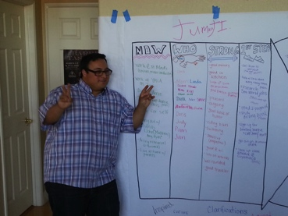
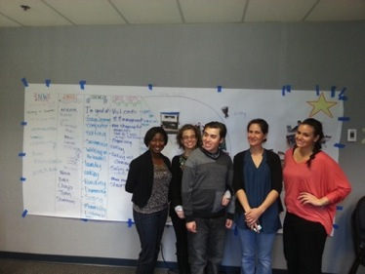
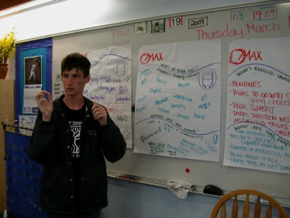
Components of PCP
Self determination
Relationships
High Expectations

Slide 3
Purpose:
TO INFORM ACTION THAT MAKES LIFE BETTER FOR PEOPLE WITH DISABILITIES AND THE PEOPLE WHO KNOW THEM & LOVE THEM

Slide 4
Where did it come from?
Person-centered planning grew out of a commitment to inclusion as a social goal, intentionally designed as an inclusive process

Slide 5
IMPLEMENTATION:
What does it take for people to gain access to an effective way to plan?
What does it take to move plans into action that makes a positive difference in people’s lives?

Slide 6
Planning Challenges:
Is it customized or are we fitting a “square peg” into a round hole?
Are we really using a person-driven approach to support?
People’s
Hopes &
Dreams
Supports &
Services
Are we letting the PCP drive the forms?
Skills &
Capacities
Are professionals adequately trained?
Notes:
Important Points to Discuss:
Issues around building trust, working together, and sharing “control” come from the way our services are structured.
For instance, our Integrated Employment program has a staffing ratio of 1:3. When you plan services for three distinct individuals, how do accommodate everyone’s needs, choices, and goals?
When a service provider, like our agency, has high staff turnover rates, what happens to a level of trust?
If staff aren’t trained well, or don’t apply their knowledge and training effectively, what happens to trust?
Activity:
None.
Materials:
None.

Slide 7
What’s the Difference?
Traditional planning
Goals fit within existing program options
Roles & boundaries are clear
Professional takes the lead
Done on schedule according to compliance requirements
Person-centered planning
Goals reflect individual choices
Roles & boundaries are created according to needs
Student takes the lead and/or plays an active role (depending on age)

Slide 8
What it is & What it is not
Deficiencies
Fitting into existing slots
Controlling the person
Filling out forms
Compliance
Capacity/Talents
Empowerment/self determi-nation
Thinking beyond what’s currently available

Slide 9
“It was really different from a 2-hour meeting where everyone else made decisions about my life!” ~ J

Slide 10
Take the EASY way or the HARD way?
It’s EASY to limit expectations/vision for each individual to match what’s currently available in the system.
It’s HARD to increase capacity so systems offer personalized supports and so communities are welcoming to people with disabilities as active participants.

Slide 11
It Takes a Change of Perspective
What could you do differently to learn about your student who is the focus of a PCP? What could you do differently to listen to the family? What could you do differently to explore possibilities in the community? What could you do differently to create options within the system?

Slide 12
How do you start?
With one person, who has interest or curiosity
+ people who know and care about that person
+ a place and time
+ some paper & markers (and a recorder)
+ some food!

Slide 13
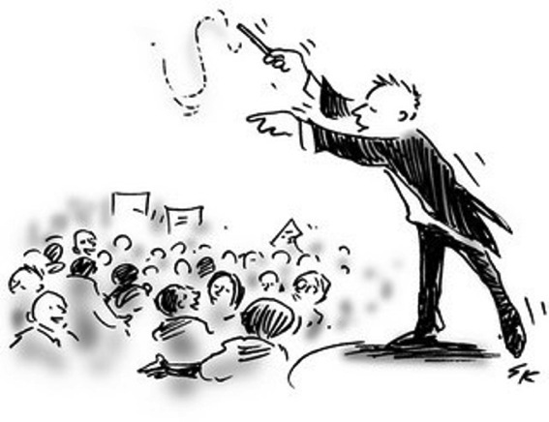
Facilitator Roles
Accountable to the individual (focus person)
Actively listen, encourage participation
Must move the group from planning to action
Invite a recorder to design the graphics (doesn’t have to be an artist)

Slide 14
The Driving Questions
How do we describe people?
Focus on gifts, capacities, dreams & desires
How do we think about and plan for the future?
Plan a future rich with community life
Who makes the decisions; who is in control?
Support personal & community decision making
What do we believe about community?
Build community & accepting relationships
What do we believe about services?
Adapt & change services

Slide 15
The Flow of the Plan
Gathering history; how did we get here?
Celebrate the little things; what are we learning? What’s next?
Dreams, visions for the future
Action plan – who will do what?
Nightmares,
things that may get in the way
Strengths, interests, choice, preferences
What does s/he want, need?

Slide 16
My first MAP with Julie
The focus individual
Participants

Slide 17
Her history
Places she goes

Slide 18
Choices
What’s working/What’s not

Slide 19
Dreams/goals
Action plan

Slide 20
Follow up meetings
WHAT’S HAPPENING? | IS IT OK? | IF NOT, WHAT TO CHANGE?
Living arrangements
Work
Recreation
Social scene
Other

Slide 21
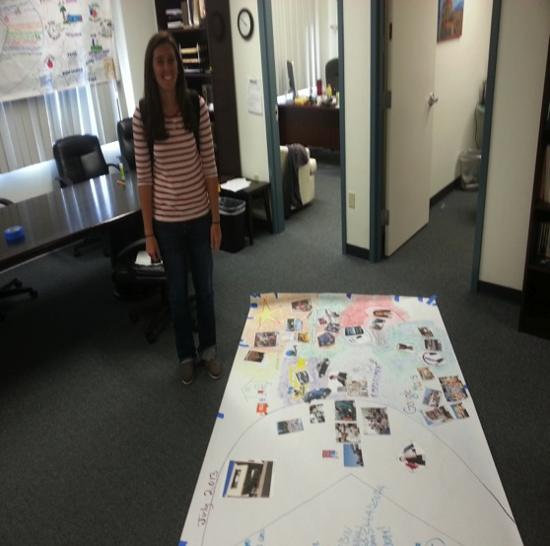
Time for an activity!
Pick a partner, grab some paper and markers, and get ready to use the other side of your brain!

Slide 22
Translating the PCP into required plans/forms:
Helps to create long-term goals, specific objectives for IEP, ITP, ISP, etc.

Slide 23
Preferred Future/Dream/Goal:
I want to live in the community in my own place.
What needs to be done to accomplish this?
Open savings account; determine how much can be deposited every month
Determine budget for rent, other living costs
Explore options for roommates, other living supports
Use library or newspapers to check apartment listings

Slide 24
Action Plan:
ITP Goal 1. I want to live in the community in my own place.
ITP Objective 1: By May 1, Joshua will open an account at his neighborhood bank and deposit at least $50 from his paycheck, following the established process using the ATM, as measured by self-evaluation forms.

Slide 25
Action Plan:
ITP Goal 1. I want to live in the community in my own place.
ITP Objective 2: By May 1, Joshua will visit at least 2 supported living agencies to gather resources on options for living alone or with a roommate.

Slide 26
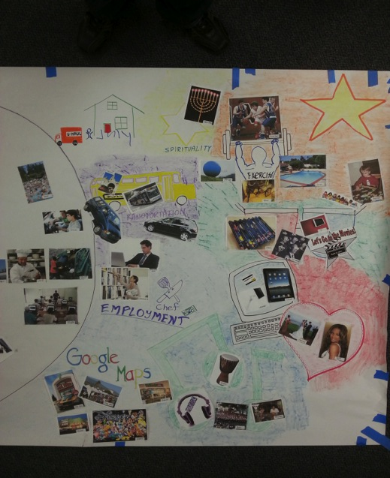
Maximum Participation
Use PCS symbols
Google images
Photos
Do a “pre-plan” to help for better preparation
Make sure that the focus individual selects the participants (may need to prioritize)
Schedule prior to IEP/ITP/ISP meetings
Customize it for more interest

Slide 27
Translating the PCP into required plans/forms:
Helps to create long-term goals, specific and measurable objectives for education, transition, employment plans

Slide 28
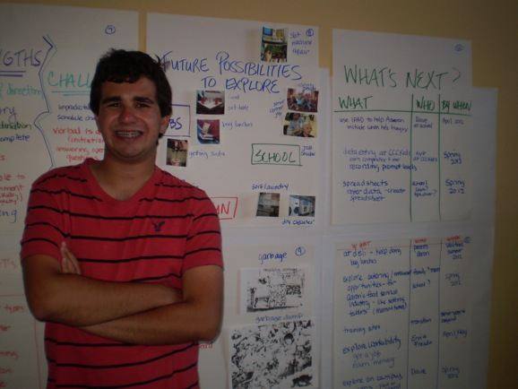
Ensure Maximum Participation
Make sure that the focus individual selects the participants (may need to prioritize)
Do a “pre-plan” to help for better preparation
Use personal photos, PCS symbols, Google images
Schedule prior to formal planning meetings
Customize it for more interest

Slide 29
Planning with Aaron – at home with family & friends

Slide 30
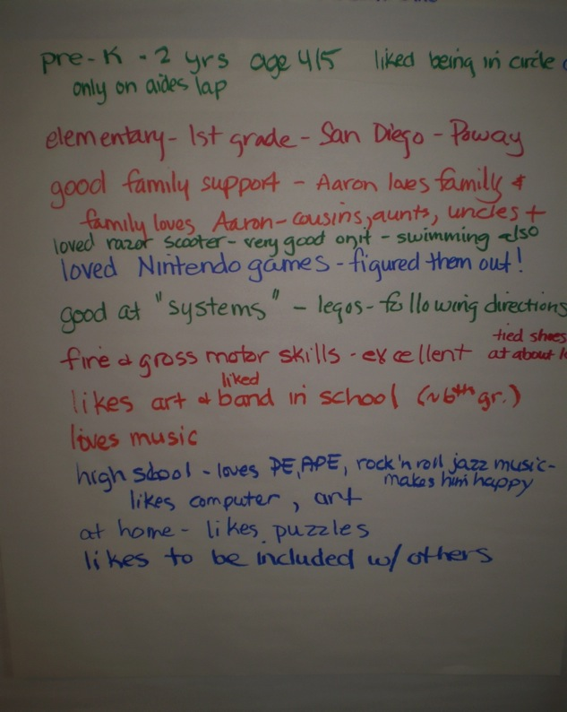

Slide 31
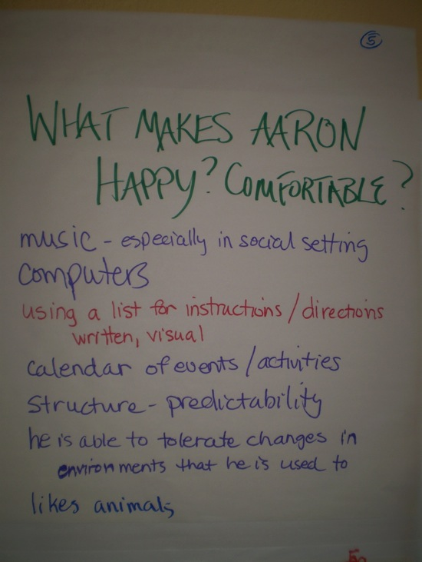
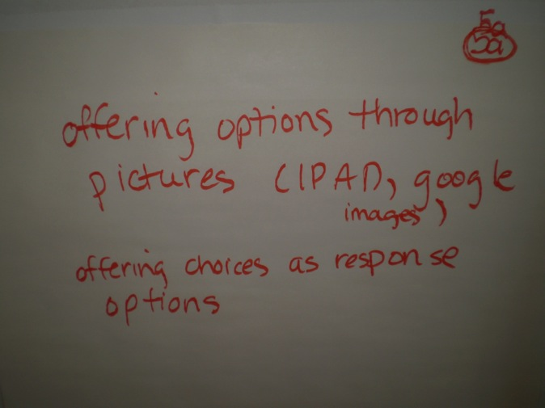

Slide 32
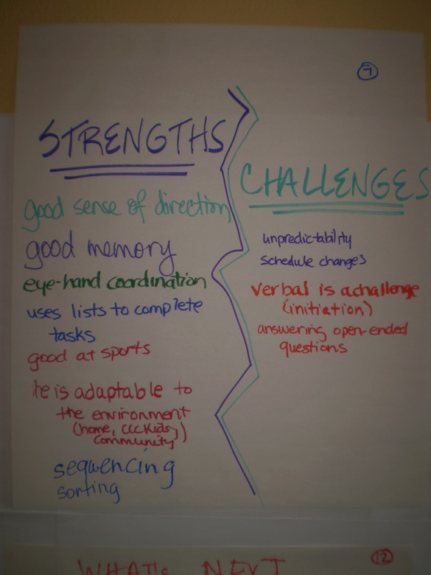
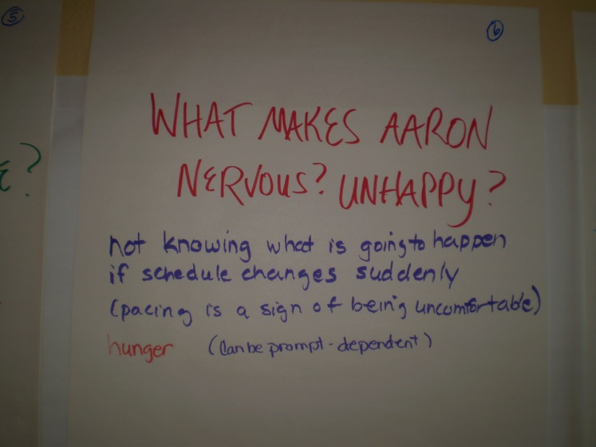

Slide 33
Translating ideas to his school transition plan

Slide 34
Made transition goals more specific
Identify job sites/environments to visit
Set up opportunities to job shadow (pet stores, animal shelters)
Explore details as to why certain jobs/environments were selected (insulation spraying; repairing slot machines)
Try out various tasks for specific jobs (related to family deli)
Identify options for volunteer work to address interest in helping people(senior center)
Begin training on public transportation

Slide 35
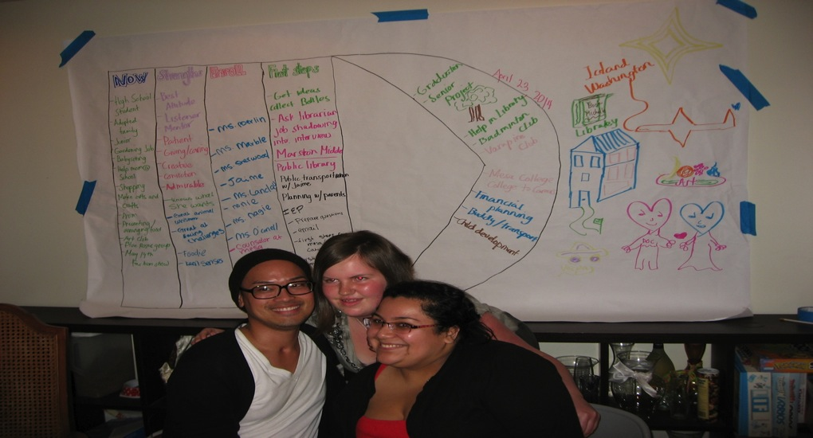
PATH
Planning Alternative Tomorrows with Hope

Slide 36
PATH

Slide 37
PATH Dreams

Slide 39
WORKING WITH FAMILIES
Meeting them where they are
Helping them draw the picture of where they are
People closest to them
Areas of support
Areas of concern or needs
Building plans for support
Helping them to feel empowered

Slide 40
Extended family
neighbors
EFMP
friends
FAMILY
School
Church support
isolation
Financial problems
Support groups
deployment

Slide 41
Any questions?
For more information, visit our website:
http://interwork.sdsu.edu/sp/takecharge/
“A true community is only able to grow and strengthen itself by including all of its members and finding room for them to develop their capacities within its own pattern of growth.”
-John McKnight

