Slide 1
Person-Driven Planning
Take Charge: Leading the Transition to Adulthood
Caren L. Sax, Ed.D., CRC, SDSU Interwork Institute
(funded by CA State Council on Developmental Disabilities, Area Board 13)

Slide 2
Top 10 Responses to: Do you do Person Centered Planning?

Slide 3
10. It takes too much time.
9. I can’t draw.
8. Students might have unrealistic expectations.
7. Parents/teachers might have unrealistic expectations.
6. Scheduling everyone is too complicated.
5. I used to do it – not sure why I stopped.
4. I can barely get through the IEPs for everyone.
3. Sounds good in theory – no one really does them.
2. Who’s going to pay for the food?
1. Of course we do!!

Slide 4
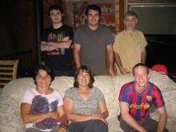
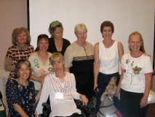
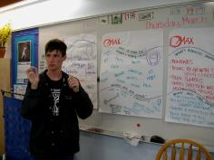
Components of PCP/PDP
Self determination
Relationships
High Expectations

Slide 5
PURPOSE:
TO INFORM ACTION THAT MAKES LIFE BETTER FOR PEOPLE WITH DISABILITIES AND THE PEOPLE WHO KNOW THEM & LOVE THEM

Slide 6
Where did it come from?
Person-centered planning grew out of a commitment to inclusion as a social goal, intentionally designed as an inclusive process; person-driven planning is an attempt to ensure that the individual is in charge of their plans.

Slide 7
IMPLEMENTATION:
What does it take for people to gain access to an effective way to plan?
What does it take to move plans into action that makes a positive difference in people’s lives?

Slide 8
Planning Challenges:
Is it customized or are we fitting a “square peg” into a round hole?
Are we really using a person-driven approach to support?
People’s
Hopes &
Dreams
Supports &
Services
Are we letting the PCP drive the forms?
Skills &
Capacities
Are professionals adequately trained?
Notes:
Important Points to Discuss:
Issues around building trust, working together, and sharing “control” come from the way our services are structured.
For instance, our Integrated Employment program has a staffing ratio of 1:3. When you plan services for three distinct individuals, how do accommodate everyone’s needs, choices, and goals?
When a service provider, like our agency, has high staff turnover rates, what happens to a level of trust?
If staff aren’t trained well, or don’t apply their knowledge and training effectively, what happens to trust?
Activity:
None.
Materials:
None.

Slide 9
What’s the Difference?
Traditional planning
Goals fit within existing program options
Roles & boundaries are clear
Professional takes the lead
Done on schedule according to compliance requirements
PCP/PDP
Goals reflect individual choices
Roles & boundaries are created according to needs
Student takes the lead and/or plays an active role (depending on age)

Slide 10
What it is & What it is not
Deficiencies
Fitting into existing slots
Controlling the person
Filling out forms
Compliance
Capacity/Talents
Empowerment/self-determi-nation
Thinking beyond what’s currently available

Slide 11
“It was really different from a 2-hour meeting where everyone else made decisions about my life!” ~ J

Slide 12
It Takes a Change of Perspective
What could you do differently to learn about your child/student who is the focus of a Plan? What could you do differently to listen to the family/professionals? What could you do differently to explore possibilities in the community? What could you do differently to create options within the system?

Slide 13
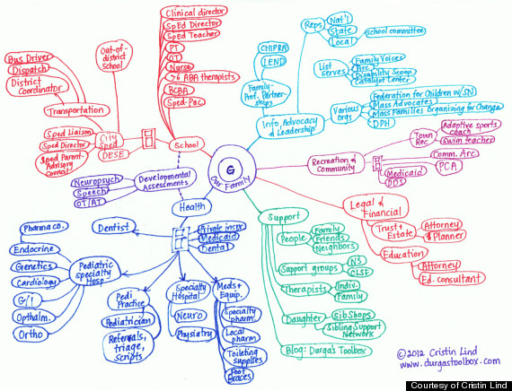

Slide 14
The Flow of the Plan
Gathering history; how did we get here?
Celebrate the little things; what are we learning? What’s next?
Dreams, visions for the future
Action plan – who will do what?
MAP
Nightmares,
things that may get in the way
Strengths, interests, choice, preferences
What does s/he want, need?

Slide 15
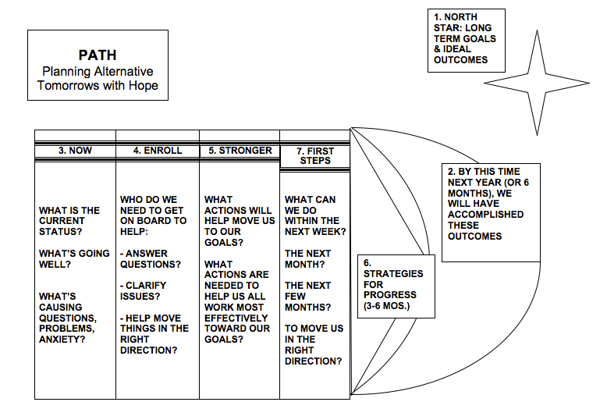

Slide 16
What we’ve done so far . . .
Introduced the concept and strategies to RCP graduate students
Provided training to those interested in committing to project
Presented information/recruited families
Facilitated pre-meetings and meetings designed to be “person-driven”

Slide 17
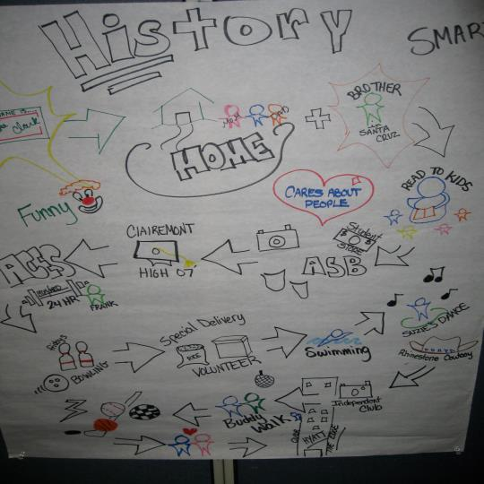
LUKE’S
ADVENTURES
PATH &
HISTORY

Slide 18
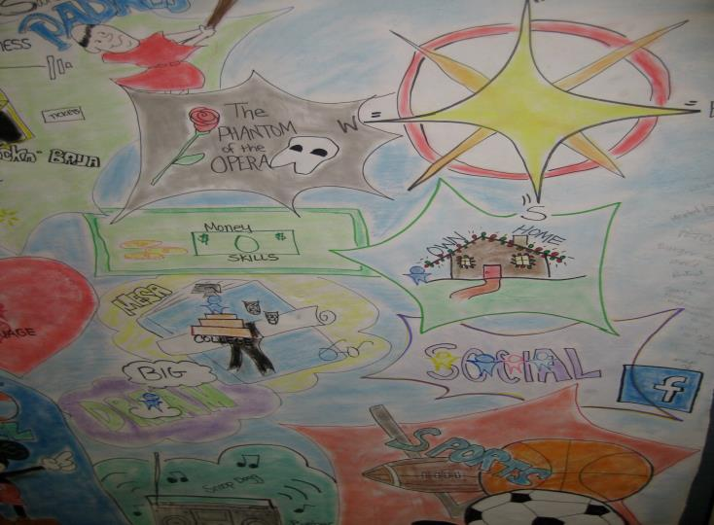
DREAMS

Slide 19
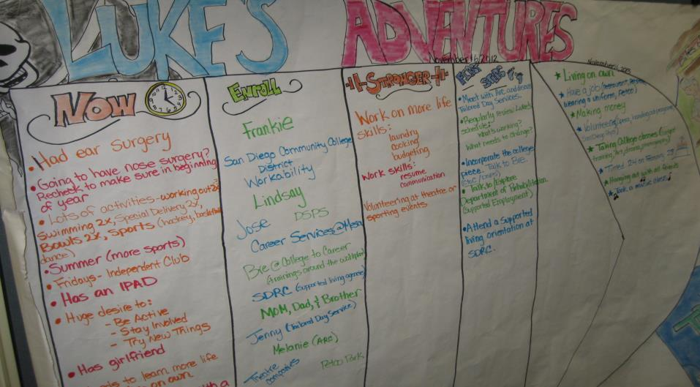

Slide 20
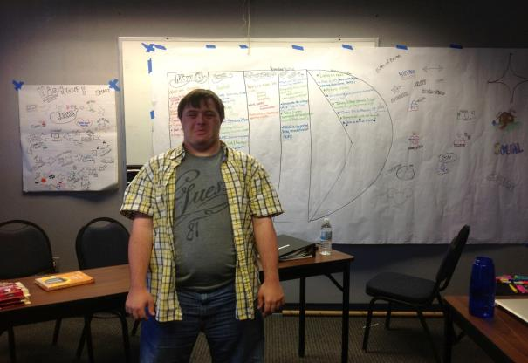
FOCUS ON SHORT TERM
Plan was specific to his needs
Helped to introduce, provide context for support person
Immediate steps

Slide 21
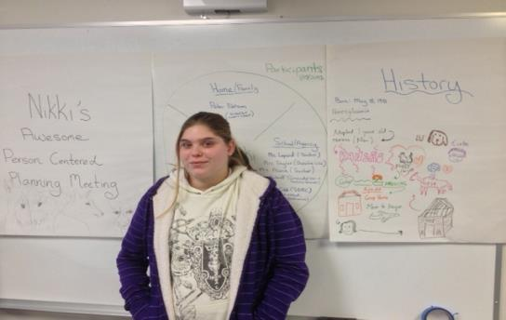
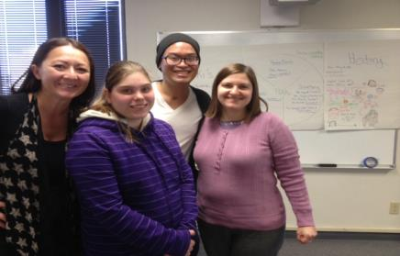
Nikki’s Awesome Meeting

Slide 22
For the non-artists among us:
Using a template, customized by student, recording directly on computer and shown via a projector; accessing Google Drive, images, photos, etc.

Slide 23
***'s Future
Planning Meeting

Slide 24
***'s History
Born: May 21, 1991 in Russia
Learned English at home, started
Kindergarten at 6 years old; met Robby during Elementary school
Welcome to the USA (5 years old);
Directly to San Diego; adopted with
his brother (Timmy)
Went to Solana Santa Fe for 4rd-6th grade
Started to play soccer, went to Warner Springs, played little league, golf, skiing; enjoyed dancing and playing the drums
Travelled to Grand Canyon, up the coast
Youth Group at Church ; last 2 years participating in “Young Life”, activities include singing
Canyon Crest for 2 years
Started USC, then to Springall, then to USC
At 18 moved to out to a “home”, then moved to current group home
Today:
November 27, 2012

Slide 25
What Works?
take deep breaths or take a walk when frustrated
prompts to take a break
small groups, writing things out, a calm relaxing environment
being outside
being given a job/clear role
setting a short-term goal and then extending
giving space to calm down
giving choices
taking breaks
waiting until he is calm to bring up an issue
privacy
tasks with an end point
physical tasks
bussing tables
creating rapport
given a warning about “hard feedback”
What Does NOT Work?
getting “in his face”
telling him to calm down
being forced to “talk about it”
teasing
confronting an issue when agitated
talking about personal issues in a group
food service (crowded)
crowds/chaos, feeling rushed
having to problem solve a task
public feedback
talking about *** in his presence without including him
Notes:
*** (what works and doesn't work for you?); Others (how should we behave/ support you? what environments work?)

Slide 26
PLANS
WHO ***, USC staff ***, USC staff ***, parents, Regional Center ***, Erin *** ***, USC staff, Regional Center | WHAT Get a driver’s license (take written test – book learning, behind the wheel training) or mobility training Get a job with support, continue with tours of programs Move to a less restrictive living environment/ supported living Get married Research sports and dance options (leisure activities) Go to a trade school (e.g., ITT Tech) or Job Corps | WHEN start after Winter Break tours are on-going No rush, in the future (by age 25) After getting and maintaining a stable job On-going Start after Winter Break

Slide 27
Maximum Participation
Use PCS symbols
Google images
Photos
Do a “pre-plan” to help for better preparation
Make sure that the focus individual selects the participants (may need to prioritize)
Schedule prior to IEP/ITP/ISP meetings
Customize it for more interest

Slide 28
J’s PATH
Use of Google images and other internet sites to illustrate J’s dreams
J’s mom: “Thank you for allowing Jory to reach for dreams as we sat in delight watching him come to terms with something completely new!”

Slide 29
Translating the PCP into required plans/forms:
Helps to create long-term goals, specific and measurable objectives for education, transition, employment plans

Slide 30
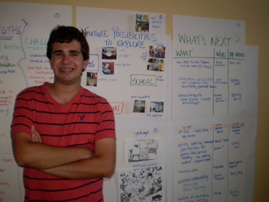
Aaron’s Plan
Aaron was headed into final year of high school (age 18)
Transition goals needed more details, more direction
Met with Aaron and his mom twice before PCP meeting for initial planning & preparation

Slide 31
Planning with Aaron – at home with family & friends

Slide 32
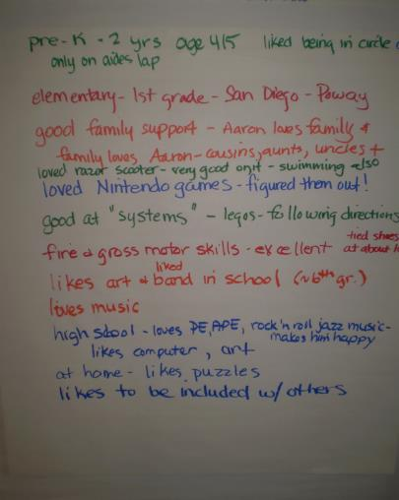

Slide 33
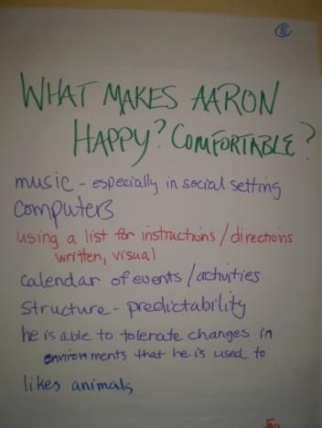
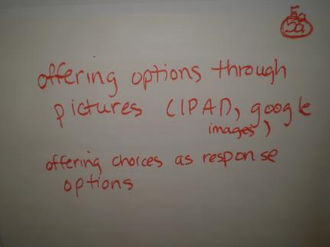

Slide 34
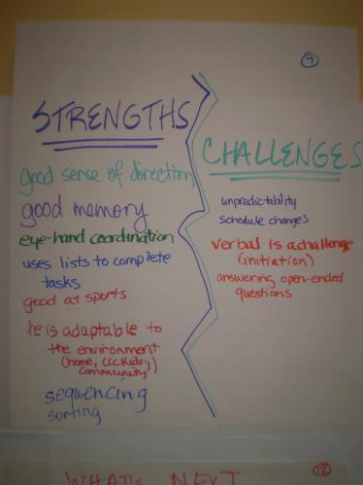
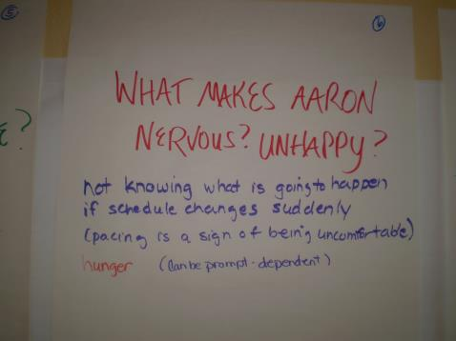

Slide 35
Translating ideas to his school transition plan

Slide 36
Made transition goals more specific
Identify job sites/environments to visit
Set up opportunities to job shadow (pet stores, animal shelters)
Explore details as to why certain jobs/environments were selected (insulation spraying; repairing slot machines)
Try out various tasks for specific jobs (related to family deli)
Identify options for volunteer work to address interest in helping people(senior center)
Begin training on public transportation

Slide 37
Comments About PCP Meetings
“This was a great way to get a lot of input on a student who was new to my caseload.” -- Teacher
“This is beautiful.” – Parent who took pictures of the PCP at the end of the meeting
2 teachers and 1 parent asked if they could have a PCP
“I’m glad all of you could be at my meeting. You’ve really helped me.” –Student
“That was really cool!” –Student
“Thanks for helping my son to dream” - Parent
Notes:
Don’t necessarily hear this after an IEP meeting; can be used for anyone (IEPS for PWD)

Slide 38
Guiding Principles
The individual is in charge: they decide who attends the meeting, where it should be, and what goes on their plan.
The meeting must be voluntary for all attendees – and everyone must agree to stay for the whole plan.
A pre-meeting is held to interact with the focus-person and family to determine the goal and logistics for the meeting and to determine how to best support the individual to be fully engaged in the meeting.
Everyone must attend a meeting with an open mind, allowing for the opportunity to think in new ways, investing in a different way to dream and attain dreams.
Share ideas that are positive and possible!

Slide 39
How to get started:
Be willing to go by the guiding principles; enable and allow for a “person-driven” approach.
Contact Kristoffel (kvandeburgt@gmail.com or Caren (csax@mail.sdsu.edu)
Start planning the food!

Slide 40
“A true community is only able to grow and strengthen itself by including all of its members and finding room for them to develop their capacities within its own pattern of growth.”
-John McKnight
http://whatcanyoudocampaign.org
BECAUSE video

