Slide 1
Using a MAP for person-driven planning
Caren L. Sax, Ed.D., CRC
SDSU Interwork Institute
Notes:
This presentation describes the components and sequence for using a MAP for futures planning and provides examples.

Slide 2
The Flow of the Plan
Gathering history; how did we get here?
Celebrate the little things; what are we learning? What’s next?
Dreams, visions for the future
Action plan – who will do what?
Nightmares,
things that may get in the way
Strengths, interests, choice, preferences
What does s/he want, need?
Notes:
This is generally the sequence of a MAP session: Gathering information; dreams for the future; nightmares or barriers to the dreams; strengths, interests, choices and preferences; needs/wants; action plans; and celebrating what happened and what’s next to continue the planning.

Slide 3
The Driving Questions
How do we describe people?
Focus on gifts, capacities, dreams & desires
How do we think about and plan for the future?
Plan a future rich with community life
Who makes the decisions; who is in control?
Support personal & community decision making
What do we believe about community?
Build community & accepting relationships
What do we believe about services?
Adapt & change services
Notes:
It’s important to set the context and values that drive the process for planning. Facilitators should explain these as “ground rules” for those who are unfamiliar with the approach. These five questions help to lay the foundation for a positive plan.

Slide 4
Setting up the frames
Participants: who’s attending, who do they represent (friends, family, school, community, professionals)
History: how did the individual get to where she is today (highlights, milestones)
Places: where does she spend her time
Choices: which are made by her; which are made by others; which are joint decisions
Notes:
To prepare for a MAP, you can use the following titles, typically one per page, if using large paper to post on the wall. Different topics may be used to customize the MAP.

Slide 5
More frames
Preferences: things that work (motivating, interesting, bring happiness); things that don’t work (boring, frustrating, upsetting)
Dreams: (short or long term) in various life areas
Action plan: who’s going to do what, by when, who’s going to follow up
Notes:
The order of these are not set in stone; some may start with dreams, others start with history. It’s important to always end with an action plan!

Slide 6
Additional frames to consider
Health considerations: depending on individual needs (what’s working, what’s necessary in medication, special care/equipment)
Respect: positive qualities/behaviors that enhance respect; odd/unusual behaviors that might prevent individual from being respected
Notes:
You may add in frames for health and behavioral considerations, depending on the individual.

Slide 7
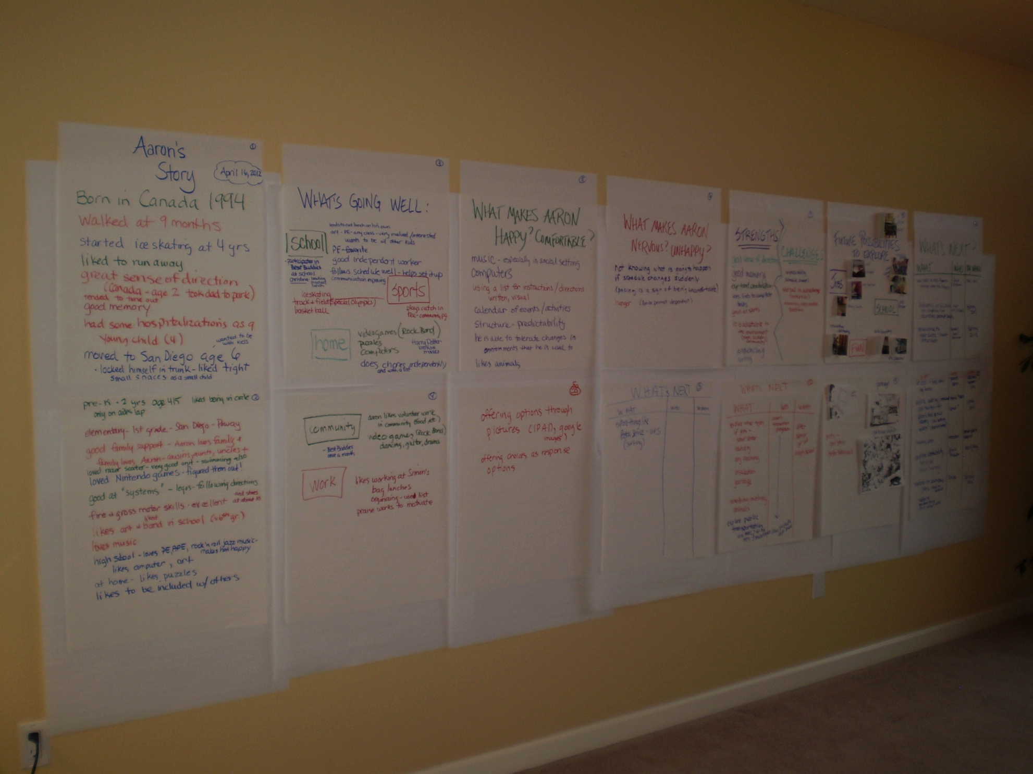
A whole MAP on the wall!
Notes:
The frames were labeled before the planning session began, with a title on each individual sheet. Then the information was filled in, allowing for some going back and forth as necessary, if someone came up with additional ideas.

Slide 8
Active engagement
Notes:
For students who may not be as verbal, they may identify photos selected ahead of time to add to the MAP, to promote their active engagement with the process.

Slide 9
Julie’s first MAP
The focus individual
Participants
Notes:
Here’s an example of a graphic of a MAP that was done with a young woman with Down Syndrome who was considering her future beyond high school. The participants were identified as representing family, friends/community, and professional service connections.

Slide 10
Her history
Places she goes
Notes:
Julie’s history was described next, showing the milestones that made her life unique and illustrated the way that her family served as “trailblazers” in having high expectations for Julie’s future. The next frame described the places she frequented, including home/neighborhood, community, school, and work.

Slide 11
Choices
What’s working/What’s not
Notes:
Julie made many of her own choices, and made some joint decisions with help from her parents. Very few decisions were made for her without any input. It was easy for her to identify things that were working for her, like shopping for her own clothes, buying her own music, making her own budget and things that didn’t, including being rushed, not being in control, arguments with her boyfriend, and funerals.

Slide 12
Dreams/goals
Action plan
Notes:
We ended with her dreams regarding school, work and her social life and living arrangements before creating the action plan of who was going to do what by when. Each of these frames were on large pieces of paper, taped to the wall so everyone could easily contribute to the discussion. At the end, it’s easy to take photos of the information so everyone has a copy and a reminder of what they committed to doing.

Slide 13
Follow up meetings
WHAT’S HAPPENING? | IS IT OK? | IF NOT, WHAT TO CHANGE?
Living arrangements
Work
Recreation
Social scene
Other
Notes:
Here’s a simple follow up plan, which Julie used when looking at any major decisions. It’s not necessary to recreate the entire plan; just hit the highlights and find out what’s still working, what’s not, and are we getting closer to our dreams.

