Slide 1
Using a PATH for person-driven planning
Caren L. Sax, Ed.D., CRC
SDSU Interwork Institute
Notes:
This presentation describes the components and sequence for using a PATH for futures planning and provides examples.

Slide 2
Planning Alternative Tomorrows with Hope = PATH
Jack Pearpoint, John O’Brien, and Marsha Forest (1993) developed the PATH tools and strategies to promote and realize a future that’s positive and possible.
The PATH requires that the focus person drives the process, along with valued friends, family, and others who care about the individual.

Slide 3
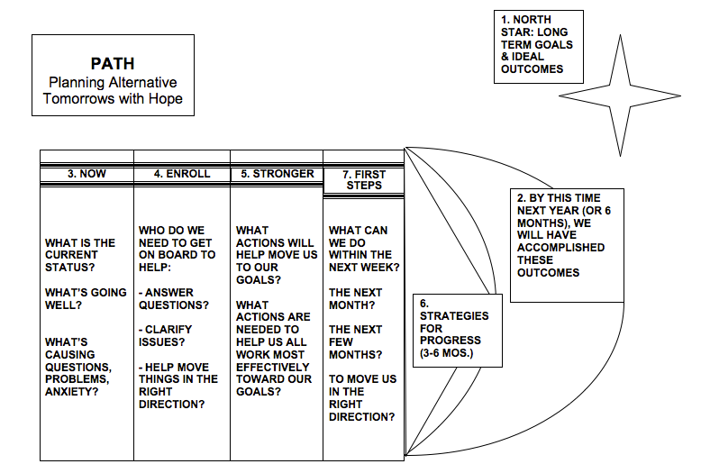
Notes:
This graphic shows the template for completing a PATH. Typically, the outline would be drawn ahead of time. The numbers indicate the sequence of the steps.

Slide 4
Steps for the PATH
North Star/Dream: Long term goals and ideal outcomes – these can be for a few years or more in the future
By this time next year, we will have accomplished these outcomes…(It’s important to use this language to say that these things will have been accomplished by then)
Now: What is the current status? What’s going well? What’s causing questions, problems, anxiety?
Enroll: Who do we need to get on board to help answer questions? To clarify issues? To help move things in the right direction?

Slide 5
More steps
5. Stronger: What actions will help us move to our goals? What actions are needed to help us all work most effectively toward our goals?
6. Strategies for progress: Looking at the next 3-6 months
7. First steps: What can we do within the next week? The next month? The next few months? To move us in the right direction? (It’s important to get people to commit – who’s going to do what by when?

Slide 6
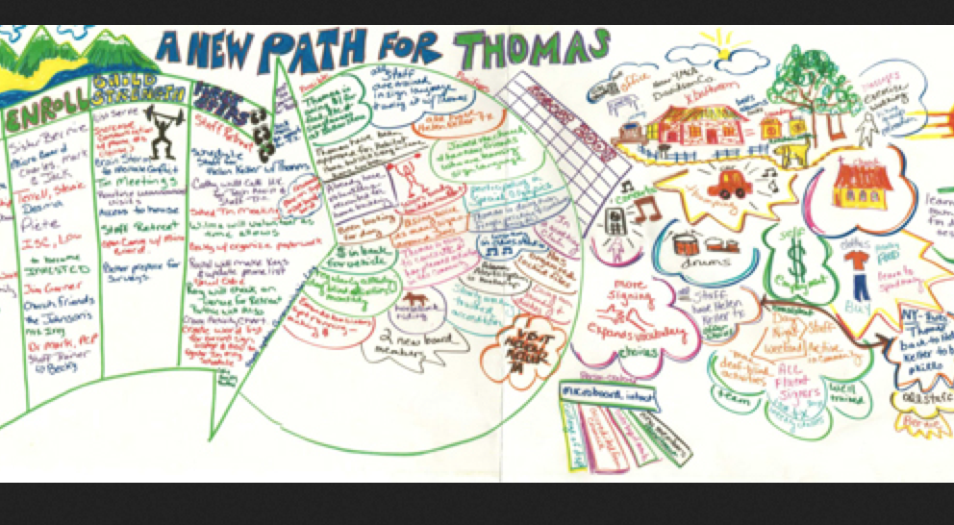
PATH sample
Notes:
Here’s a PATH completed for a young man, Thomas, considering his future.

Slide 7
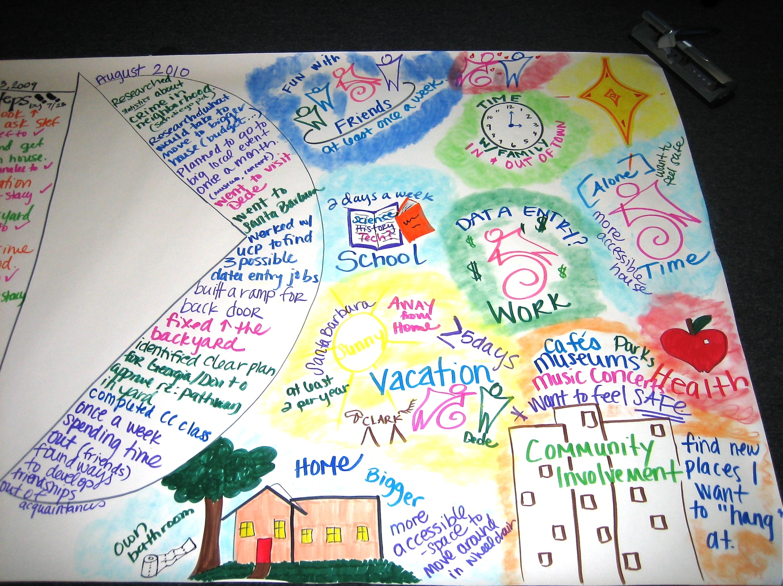
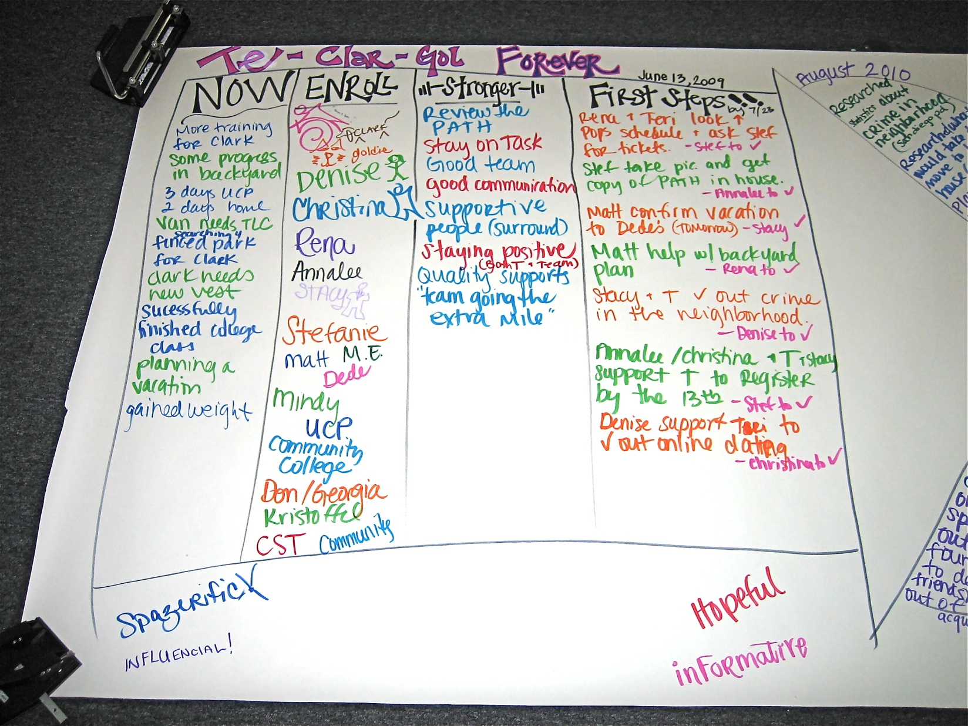
And another example

Slide 8
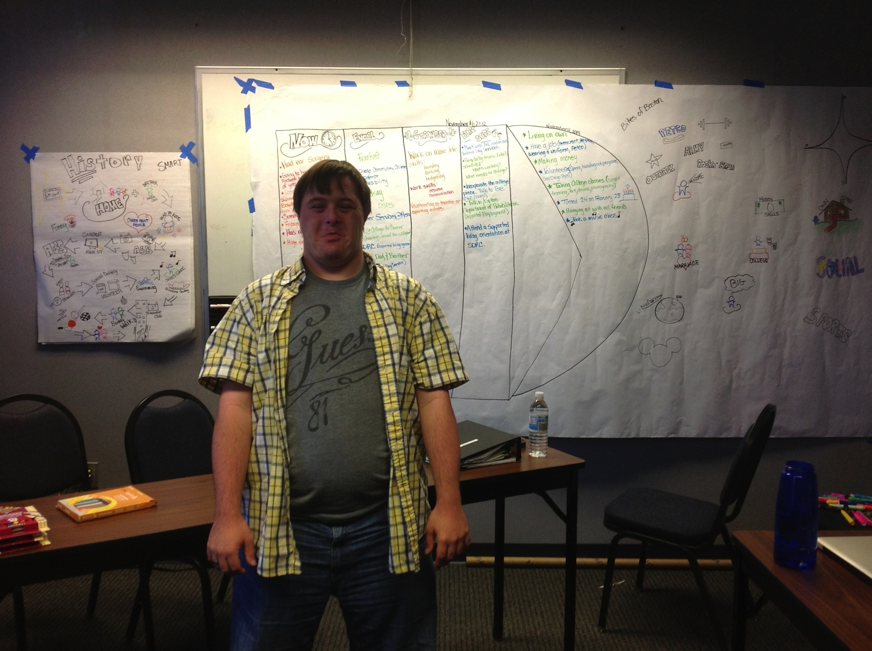
A customized PATH in progress
Notes:
This PATH was customized by doing a short history (on the separate paper hanging to the left of the PATH) before starting on the rest of the planning, starting with the dreams or North Star. Typically the graphics are used primarily for the dreams/North Star, with the other information recorded in words, using different colors to make the visuals stand out.

