Slide 1
College SUCCESS
Supported by Foundation for Developmental Disabilities
UCSD, SDSU, CSUSM, SDCCD
Intricate Mind Institute, CASRC at RCHSD

Slide 2
College SUCCESS
The College SUCCESS program was designed for increasing “soft skills” in college students to promote success in College settings. "Soft skills" are often described as a cluster of executive functioning and social abilities that directly contribute to educational success. These skills facilitate academic performance by aiding the student in work completion, class attendance, positive social interactions with peers and professors and accessing needed supports and services

Slide 3
Project Objectives
1. The College SUCCESS curriculum was developed and includes 26 group intervention sessions, delivered 1x per week between 1.5-3 hr sessions (depending on campus). UCSD campus requested that 2 sessions be taught per week over a longer course hour to fit the intervention into the quarter system.
2. A student workbook was written, a facilitator guide was written, and handouts for professors/professionals and caregivers were developed. All students appreciated receiving their own student workbook. The workbooks were used to provide the information in written and visual forms, provide practice exercises and to be a reference for students to review or refer back to now and into the future.
3. The training of the campus disability service program staff and collaborators in the SUCCESS program found to be too difficult with in this initial grant’s limited resources.

Slide 4
Participant Samples
A total of 30 students were referred to program across campuses: UCSD=11, SDSU=6, CSUSM=5, SDCCD=8. Of these referrals,
  4 declined to participate,
  2 did not respond
  2 had a conflict with meeting time.
22 students participated in the SUCCESS groups and 5 dropped over the course of the pilot study: UCSD=4, CSUSM=1.

Slide 5
Participant Demographics (n=25)
Age m= 22.16 (sd=4.1) range, 18-34, 76% male, 24% female
36% Hispanic, 56% Not Hispanic
60 % white, 12% black, 12% Asian/PI, 4% Native American/Alaskan Native, 12% unknown
24% 1st year College, 28% 2nd year, 32% 3rd, 8% 4th yr, 4% Masters, 4% Doctoral
24% enrolled in SDRC, 76% enrolled in College Disability Services, 16% enrolled in Dept of Rehab, 32% receiving Mental Health therapy, 16% on Medication
68% Live with family, 24% live with friend/roommate, 16% live alone
96% reported receiving an Autism Spectrum diagnosis

Slide 6
Summary of Outcomes
50% of participants demonstrated improvements on executive functioning skills (CT observation measure)
73% of participants reported improvements in executive functioning skills (BRIEF measure)
88% of participants demonstrated improvements of social skills (SSPA observation measure)
64% of participants reported improvements in social skills (SRS-2 self-report measure)
70% of participants reported improvements on learning and memory skills used in academic setting and 100% were observed by the facilitator to use new learning and memory skills in course
75% of participants reported improvements in social communication skills in academic settings and 100% were observed by the facilitator to use new social communication skills in course
100% of participants reported the SUCCESS program overall was excellent and 92% reported it helped them. 92% reported they would recommend it to a friend/classmate
100% of parents reported the SUCCESS program overall was excellent and 100% reported it helped their young adult. 100% reported they would recommend it to a friend/classmate
100% of the College campuses participating in SUCCESS program reported an interest in continuing it on their campus.

Slide 7
One Student email about Try It and Apply It assignment
Sent: Thursday, April 13, 2017 6:16 PM
To: Fitch, Meghan
Subject: Try it and Apply It
Hi Meghan, earlier this week, the mistake I made was I forgot to turn in an assignment and the professor told me about it and I accepted and acknowledged the mistake by apologizing and I corrected my mistake by turning in the assignment. Since it was late, I did an extra credit assignment to make up for lost points. I will prevent myself from making this mistake next time by setting a reminder.

Slide 8
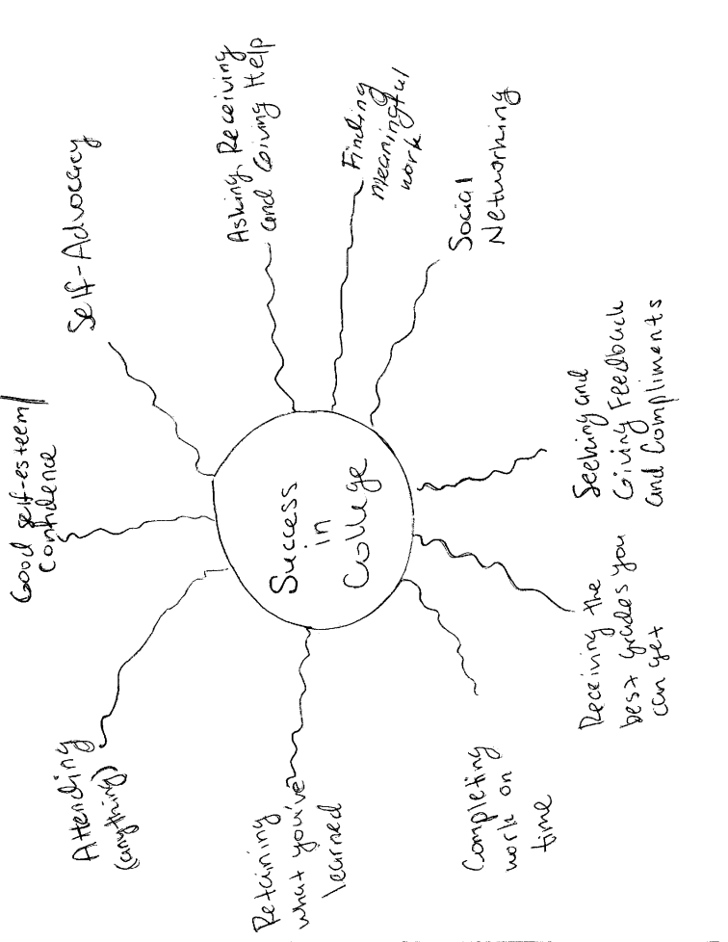
College SUCCESS
Notes:
As part of the SUCCESS program students develop personal goals to be more academically and vocationally successful. These goals are individualized by each student. All of the students reported successfully reaching one or more of their goals. Here are a few notable goals accomplished:
1 student joined the campus newspaper as a journalist
1 student participated in school events and attended job fairs
1 student got a girlfriend
2 students sought out and received disability services (and improved academic performance)
1 student wrote an article on students with Autism during Autism Awareness month
1 student provided a speech on Autism on campus during a diversity awareness event

Slide 9
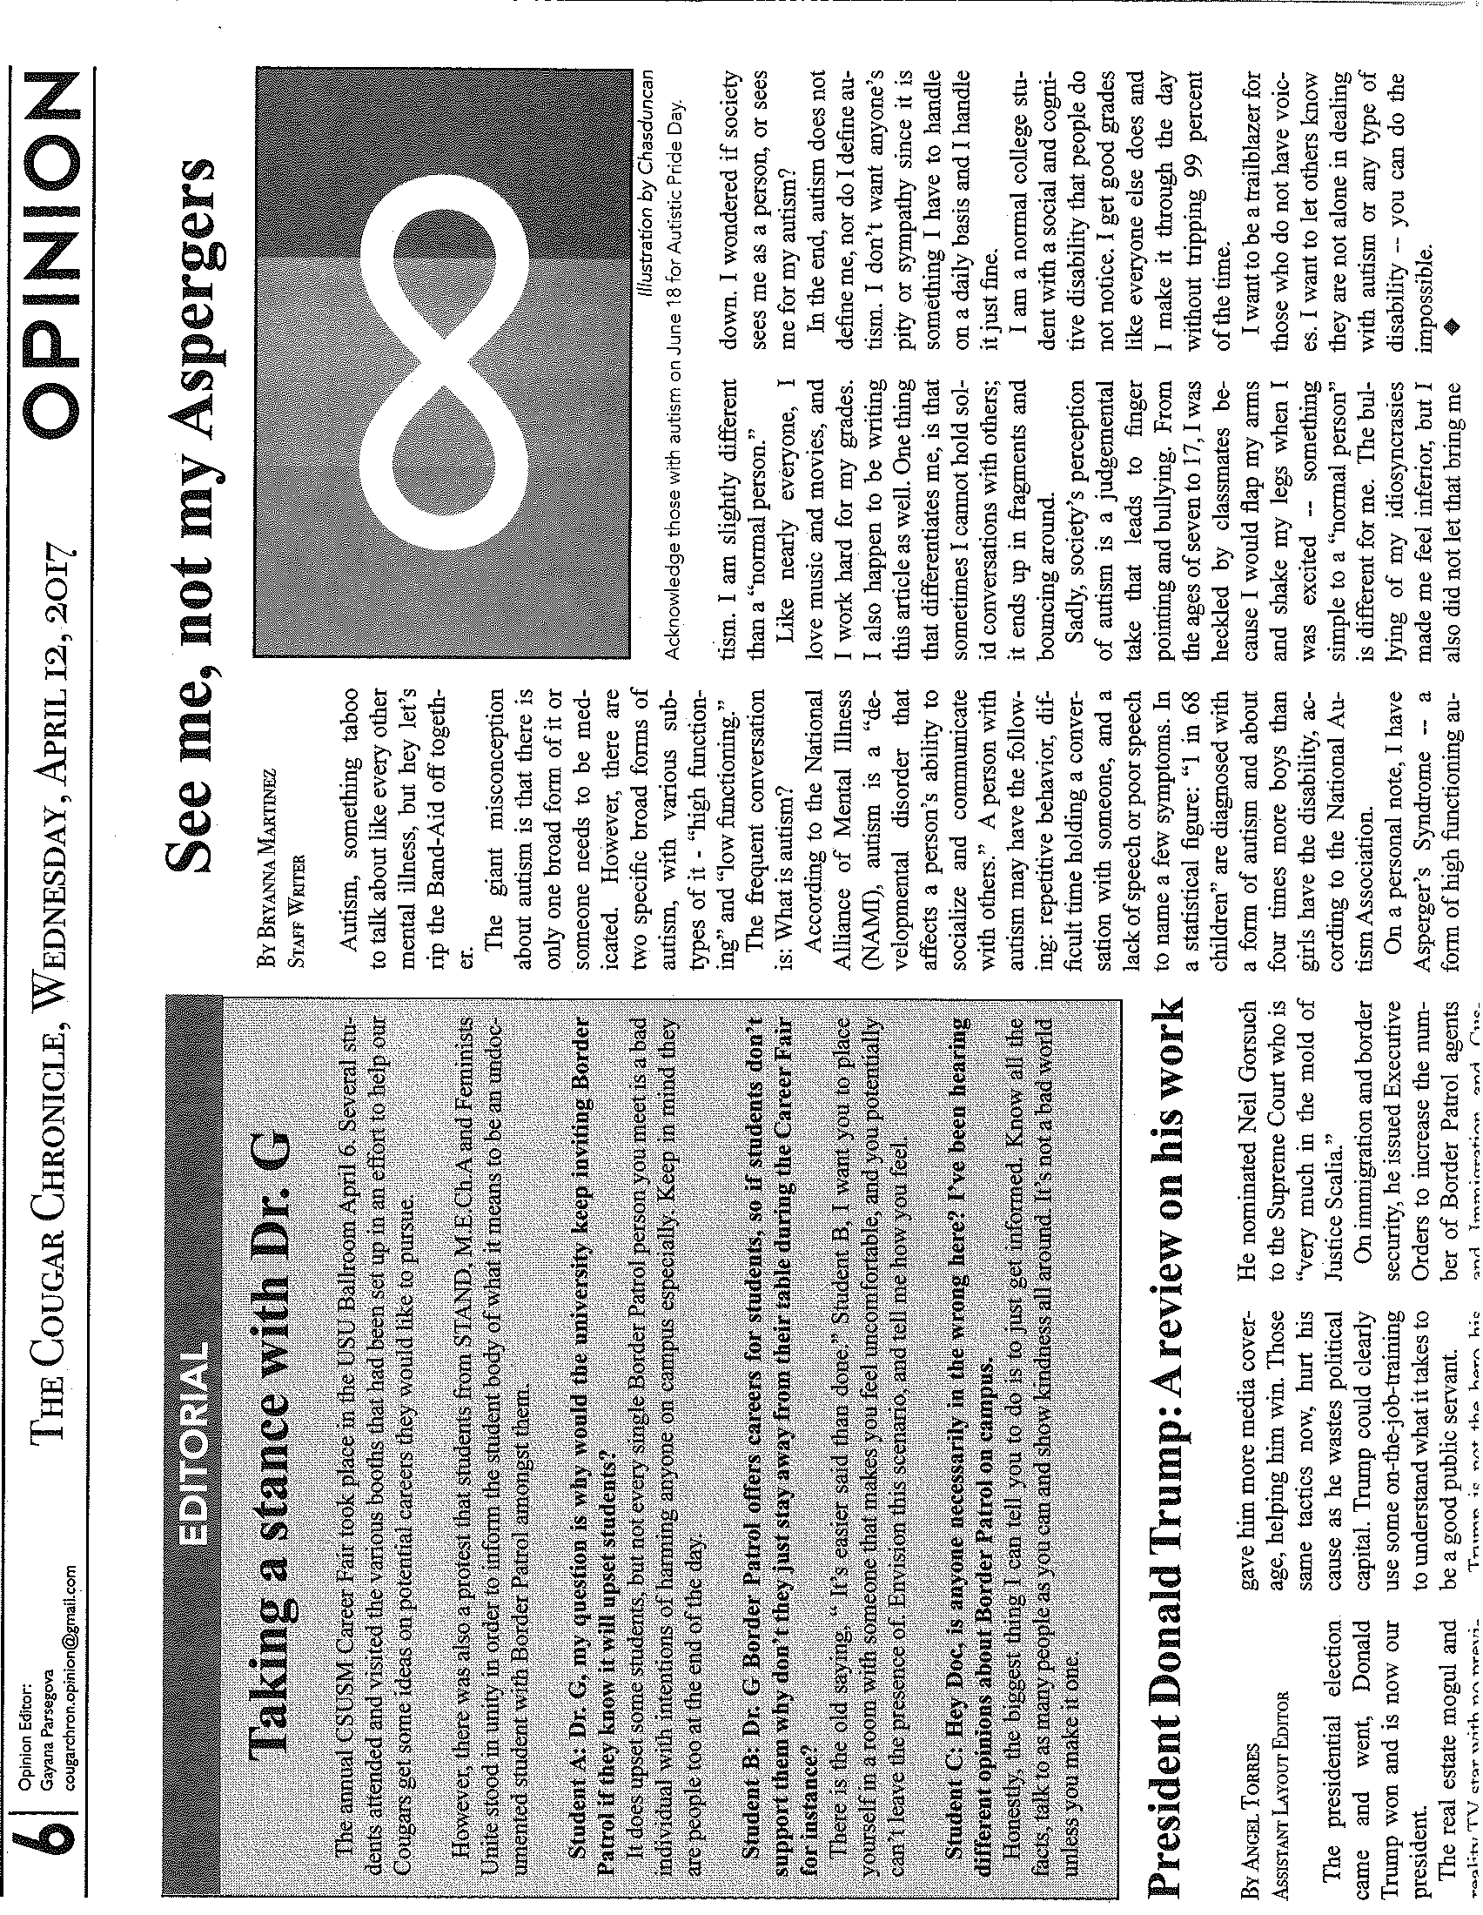
The Cougar Chronical

Slide 11
Parents reported positive changes in their sons/daughters:
“Big changes! He began a relationship. He has a girlfriend.” – CITY
“She speaks up if she does not agree or like something. [She] is more assertive” - CSUSM
“He seems more self-confident interacting with others and that has helped him do more things by himself “– CITY
“She goes out to student events more “– UCSD
“Seems more comfortable in social situations, has become more aware of what others are feeling, and offers comfort to others when they are sad. Seems less dependent on others meeting what he needs.” – CITY

Slide 12
Self & Parent Report: Executive Functioning Skills
BRIEF-A n=11 | Participant Pre and Post |  |  |  | Parent Pre and Post
T-Scores | pre-mean | post-mean | effect size | p- value | pre mean | post-mean | effect size | p-value
Inhibit | 53.3 | 49.6 | -.35 | .07 | 56.8 | 50.4 | -.63 | .05
Shift | 65.6 | 59.3 | -.53 | .04 | 63.6 | 62.3 | -.09 | .38
Emotional control | 49.9 | 46.5 | -.30 | .12 | 52.3 | 48.9 | -.32 | .17
Self-monitor | 53.5 | 48.3 | -.49 | .06 | 49.6 | 46.6 | -.31 | .21
Initiate | 59.4 | 58.2 | -.09 | .31 | 60.9 | 62.2 | -.09 | .39
Working memory | 63.3 | 56.9 | -.42 | .02 | 64.9 | 56.8 | -.59 | .03
Plan/organize | 61.7 | 57.8 | -.34 | .08 | 61.1 | 59.9 | -.08 | .37
Task monitor | 57.7 | 56 | -.15 | .24 | 62.3 | 59.4 | -.19 | .27
Organization of materials | 58.7 | 56.1 | -.20 | .07 | 57.7 | 57.4 | -.02 | .47
Behavioral Regulation Index | 55.4 | 50.1 | -.47 | .03 | 55 | 50.9 | -.39 | .14
Metacognition Index | 62.2 | 58.8 | -.26 | .04 | 62.3 | 60.2 | -.15 | .31
Global Executive Composite | 60.3 | 55.5 | -.37 | .03 | 59.7 | 56.3 | -.26 | .21

Slide 13
Self & Parent Report: Social Functioning Skills
SRS-2 n=11 | Participant Pre and Post |  |  |  | Parent Pre and Post
T Scores | pre-mean | post-mean | ES | p | pre -mean | post-mean | ES | p
Social awareness | 58.5 | 55.7 | -.30 | .09 | 57.6 | 59.9 | .16 | .33
Social cognition | 59.9 | 56.9 | -.45 | .05 | 63.7 | 58.6 | -.44 | .14
Social communication | 63.1 | 59 | -.47 | .01 | 67 | 61.2 | -.67 | .04
Social motivation | 64.5 | 59.5 | -.44 | .00 | 66.2 | 61.6 | -.46 | .10
RRBS-Total | 63.9 | 61.8 | -.20 | .15 | 66.6 | 62.9 | -.29 | .18
SCI Domain Total | 63.3 | 58.9 | -.51 | .00 | 66 | 61.2 | -.51 | .09
SRS-2 Total | 63.5 | 59.6 | -.45 | .01 | 66.6 | 62 | -.45 | .12

Slide 14
Where to go from Here?
College course
Funding mechanism
Professional staff/faculty training
Dissemination

